Slide 1
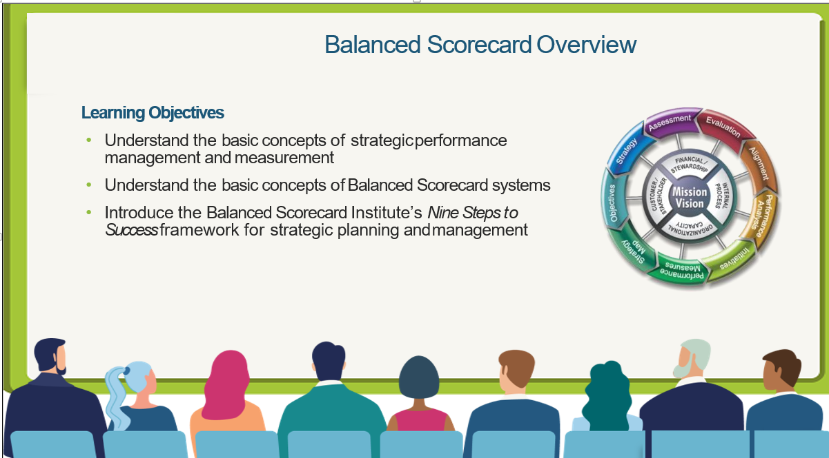
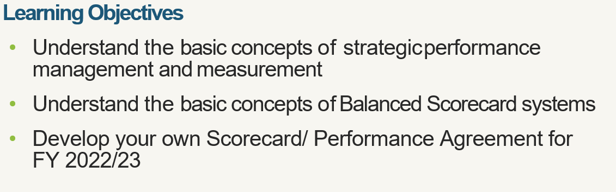

Slide 2

What is Balanced Score Card (BSC)?
An integrated strategic planning and performance management system
It’s a system that strikes a balance between all aspects of an organization
Financial and non-financial
Internal and External
Long term and Short term
Strategic Initiatives and Measures/ KPIs
Targets and Results
Lead and Lag (Predictive Vs Output)
Perspectives
Scorecard

Slide 3
Balanced Score Card…
Is a strategic management tool that helps us to bring our vision to life by;
Clarifying how we’re going to achieve our vision
Defining how we’re going to measure our progress
Enabling each of us to see how we contribute to our success

Slide 4
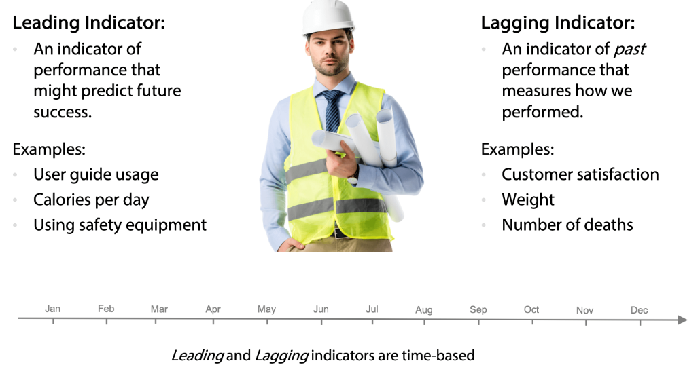
Leading and Lagging Indicators – Cause & Effect Chain
Lag – For Decision Making
Lead – For Performance Measurement
Discussion: What drives High Performance?

Slide 5
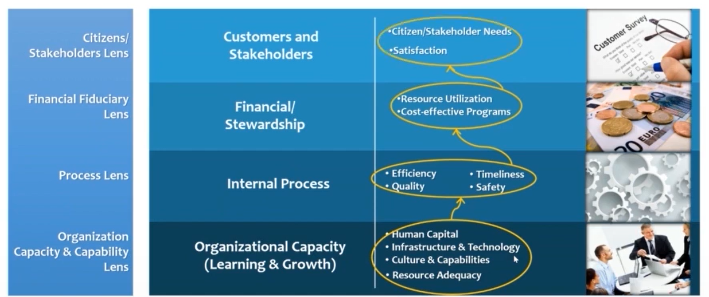
Scorecard Logic

Slide 6
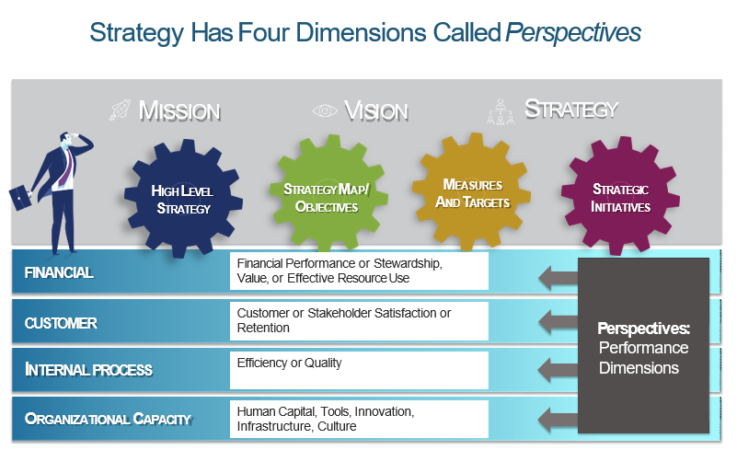

Slide 7
Role of BSC…
The Balanced Scorecard process allows an organization to align and focus all its resources on its strategy
STRATEGY
BUSINESS UNITS
EXECUTIVE TEAM
HUMAN RESOURCES
INFORMATION
TECHNOLOGY
BUDGETS AND CAPITAL INVESTMENTS

Slide 8
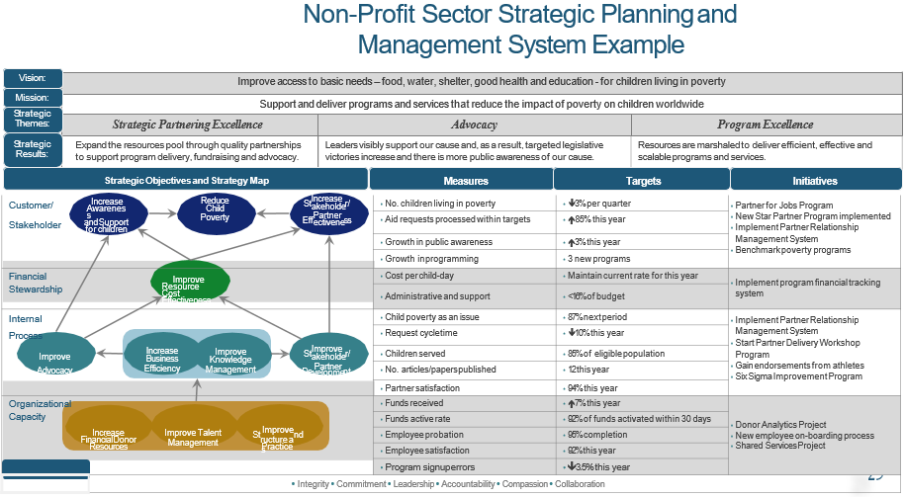

Slide 9
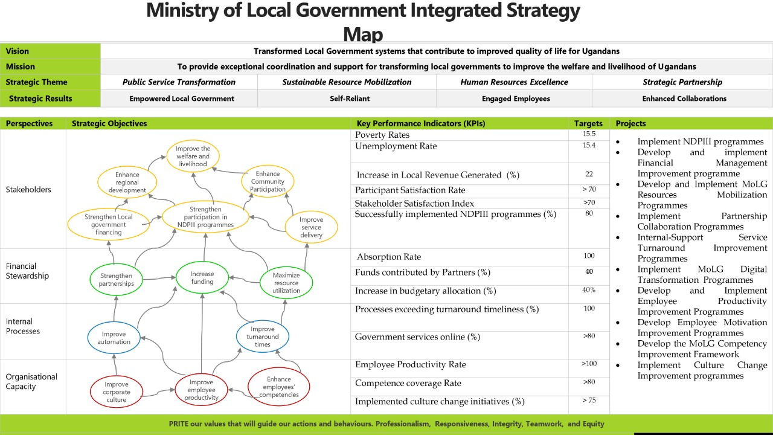

Slide 10
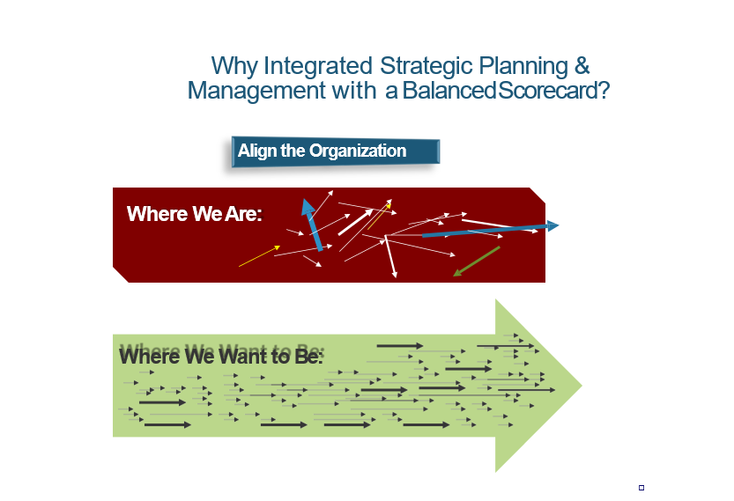

Slide 11
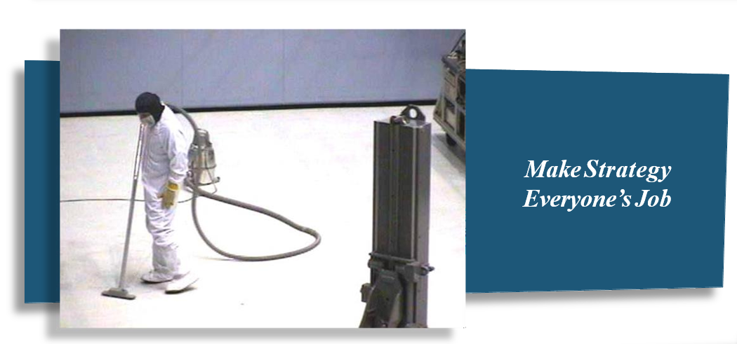

Slide 12
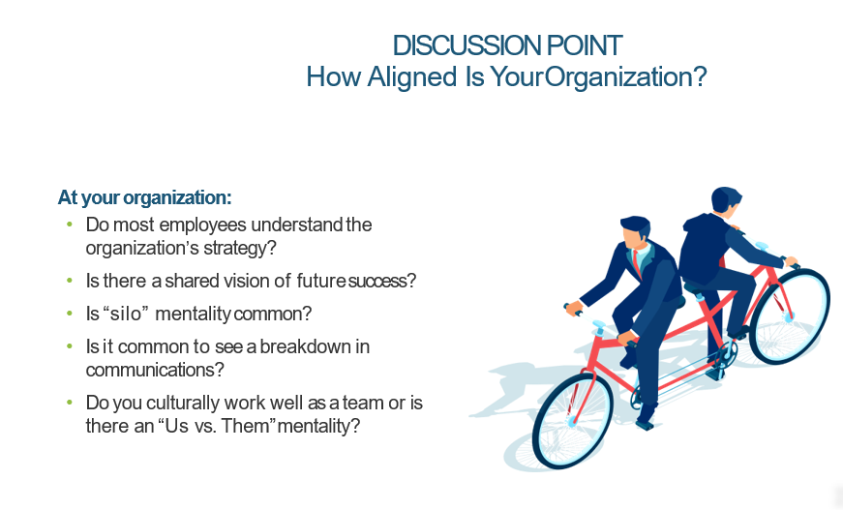

Slide 13
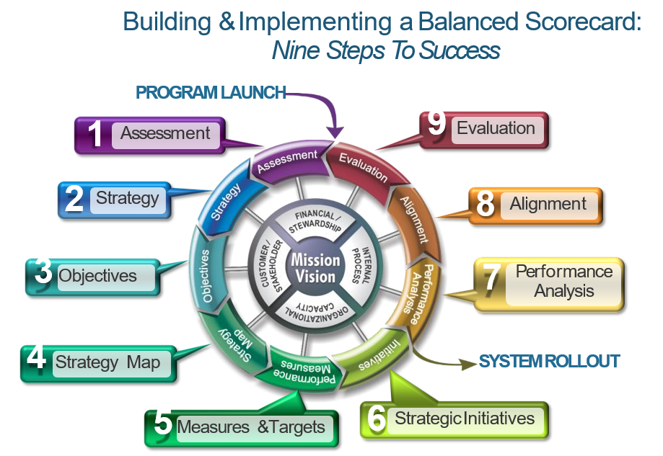
Why Balanced Scorecard?

Slide 14
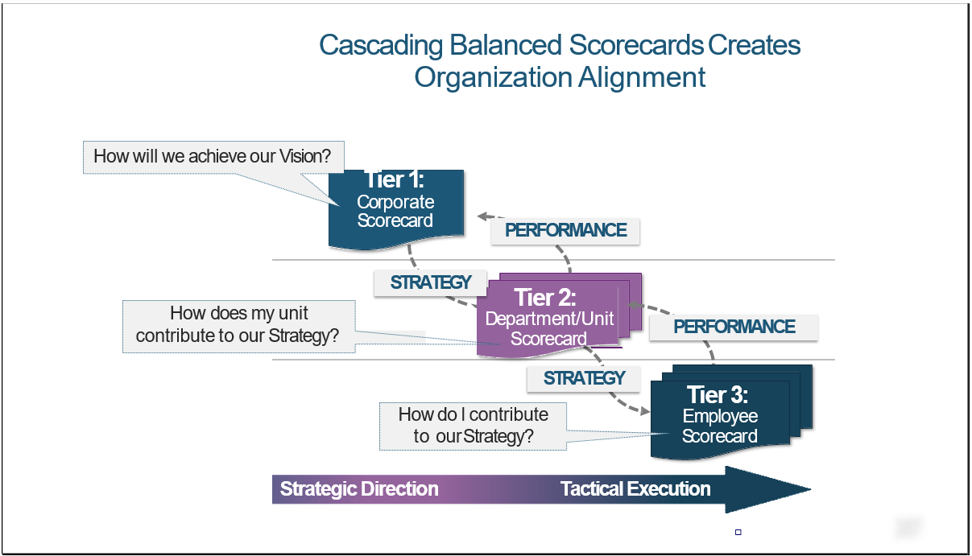

Slide 15

Ministry of Public Service (MoPS)-Uganda Strategy Map
Vision: A responsive and productive Public Service that promotes good governance for National transformation
Mission: To provide responsive human resource management systems that facilitate Public sector transformation
Strategic Pillars | Empowered workforce | Client Service Excellence |  | Operational Efficiency
Strategic Results | Highly satisfied and engaged employees, reduced turnover, high a performing workforce and transformed public service | Accessible, dependable, and error-free services, reduced complaints, high client satisfaction, high Public Trust, and a reputable image. |  | Technology Driven, integrated, standardized, innovative, risk-free processes and improved turnaround time
 | Strategic Objectives | KPIs | Targets (5year) | Strategic Initiative
Stakeholders & Clients |  | Client Satisfaction Index | 77 | Review and develop management and operational standards in the public service
 |  | Global competitiveness index | 55 | Implement the NDPIII programmes to transform public service
 |  | Governance Compliance Rate | 100 | Streamline Government structures and Governance systems
Financial Stewardship |  | Revenue Growth (%) | 15 | Implement Ministry a resources mobilization Strategies
 |  | Budget Absorption Rate | 100 | Implement a Budget management framework
Internal Business Processes |  | Government effectiveness Index | 0.01 | Decentralized service delivery for the Ministry
 |  | Client Charter Compliance Rate | 100 | Initiate programmes to make Ministry the centre of excellence in service delivery
 |  | Technology Adopted (%) | 100 | Automate Ministry service delivery systems and processes
 |  | Innovation implemented (%) | 75 | Institutionalize research and innovation in the Ministry
Organisational Capacity |  | Employee Satisfaction Index | 85 | Implement a total rewards and sanctions system for the Ministry
 |  | Competent employees (%) | 95 | Implement Talent management Framework
 |  | Cultural Infusion (%) | 70 | implement a mindset change and culture infusion programme for the Ministry
Core Values: Integrity-Professionalism-Client focus-Innovativeness
Transform Public Service
Enhance Client satisfaction
Strengthen governance capacity
Mobilise resources
Increase budget absorption
Increase Government effectiveness
Enhance innovation
Increase technology adoption
Improve turnaround time
Enhance employee engagement
Improve Ministry culture
Strengthen employee competences

Slide 16
Ministry of Local Government Integrated Strategy Map
Vision | Transformed Local Government systems that contribute to improved quality of life for Ugandans
Mission | To provide exceptional coordination and support for transforming local governments to improve the welfare and livelihood of Ugandans
Strategic Theme | Public Service Transformation | Sustainable Resource Mobilization | Human Resources Excellence | Strategic Partnership
Strategic Results | Empowered Local Government | Self-Reliant | Engaged Employees | Enhanced Collaborations
Perspectives | Strategic Objectives | Key Performance Indicators (KPIs) | Targets | Projects
Stakeholders |  | Poverty Rates | 15.5 | Implement NDPIII programmes Develop and implement Financial Management Improvement programme Develop and Implement MoLG Resources Mobilization Programmes Implement Partnership Collaboration Programmes Internal-Support Service Turnaround Improvement Programmes Implement MoLG Digital Transformation Programmes Develop and Implement Employee Productivity Improvement Programmes Develop Employee Motivation Improvement Programmes Develop the MoLG Competency Improvement Framework Implement Culture Change Improvement programmes
 |  | Unemployment Rate | 15.4
 |  | Increase in Local Revenue Generated (%) | 22
 |  | Participant Satisfaction Rate | > 70
 |  | Stakeholder Satisfaction Index | >70
 |  | Successfully implemented NDPIII programmes (%) | 80
Financial Stewardship |  | Absorption Rate | 100
 |  | Funds contributed by Partners (%) | 40
 |  | Increase in budgetary allocation (%) | 40%
Internal Processes |  | Processes exceeding turnaround timeliness (%) | 100
 |  | Government services online (%) | >80
Organisational Capacity |  | Employee Productivity Rate | >100
 |  | Competence coverage Rate | >80
 |  | Implemented culture change initiatives (%) | > 75
PRITE our values that will guide our actions and behaviours. Professionalism, Responsiveness, Integrity, Teamwork, and Equity
Improve the welfare and livelihood
Enhance regional development
Enhance Community Participation
Strengthen Local government financing
Strengthen participation in NDPIII programmes
Improve service delivery
Strengthen partnerships
Increase funding
Maximize resource utilization
Improve automation
Improve turnaround times
Improve corporate culture
Improve employee productivity
Enhance employees’ competencies

Slide 17

Integrated Strategy Map
Vision | A Prosperous, Productive and Healthy population by 2040
Mission | To provide high quality and coordinated services to the community by focusing on both national and local priorities
Perspectives | Strategic Objectives | Key Performance Indicators (KPIs) |  | Initiatives
Stakeholders |  | Poverty Rates | 25 | Agro – Industrialization programmes
 |  | Share of working population (%) | 43 | Private Sector Capacity drive
 |  | Population growth rate (%) | 2.93 | Environment, Climate Change and Natural Resource Management Programmes
 |  | Change in Agricultural production Volumes (%) | 42 | Human Capital Development and Social Protection Programmes
Financial Stewardship |  | Currency (Ugx) | 0.255B | Budgeting and resource mobilization Plan
 |  | Currency (Ugx) | 5B | Local Revenue enhancement plan
 |  | Resources utilization (%) | 100 | Public resources utilization plans
Internal Processes |  | Turnaround Satisfaction Rate | >80 | Development Plan Implementation
 |  | Services Digitized (%) | 100 | Implement Electronic Revenue systems
 |  | Local Government Performance Rank | Top 10 | Governance and Security strengthening Initiatives
Organisational Capacity |  | Employee Engagement Index | >80 | Implement Rewards and Sanction systems
 |  | Competent Employee (%) | >90 | Implement Capacity building programmes
 |  | Employee net promoter score (eNPS) | >9 | Behavioral and Mindset Change
 |  | Governance Compliance Rate | 100 | Governance Improvement programmes
Core Value (APITIC) : Accountability-professionalism-integrity-teamwork-inclusiveness And Client Focus
Improve the Quality of Life
Reduce Poverty
Increase Household Incomes
Enhance value addition
Maximize resources utilization
Increase Central Govt Funds
Increase local revenues
Improve turnaround time
Strengthen decentralization system
Digitize District services
Improve employee Engagement
Strengthen employee competencies
Strengthen Governance system
Transform Corporate Culture

Slide 18


Entebbe Municipality Council Integrated Strategy Map
Vision | A model self-sustaining municipality with a prosperous people by 2040
Mission | To ensure sustainable service delivery to the satisfaction of the people of Entebbe
 | Strategic Objectives | Key Performance Indicator | Targets | Strategic Initiatives/Projects
Stakeholders |  | Reduced Poverty rates annually | 1.5 | Implement 100% of NDP programmes targeting the municipality in MDP
 |  | Reduction of households dependent on subsistence agriculture annually (%) | 3 | Implement 100% Agro-industrialization programmes in MDP
 |  | Crop and animal products value added annually (Million Tons) | 5 | Implement 100% Value addition initiatives in MDPP
 |  | Jobs created by the Industrial sector annually (%) | 8 | Implement 100% Private sector initiatives in the MDP
Financial Stewardships |  | Increase in central government transfer annually (%) | 10
 |  | Increase in Local government |  | Local revenue enhancement programmes
 |  | New Donors/Funders annually (%) | 50% | Develop and Implement Resource Mobilization strategies
 |  | Budget Absorption rate annually | 100
Internal Processes |  | Increase of Government effectiveness Index annually | 0.124 | Public sector Transformation
 |  | Turnaround Time delays reduced annually (%) | 100 | Develop or update Client Charter Service Standards
 |  | Improved municipal government processes annually (%) | 100 | Undertake Process mapping
 |  | Digitalize government service annually (%) | 100 | Develop or Update Government Digitalization initiatives
Organisational Capacity |  | Increase in employee engagement index annually | >5 | Implement a reward management system
 |  | Increase in employee skills and knowledge (%) | >10 | Implement an annual training programme
 |  | Annual Employee Net Promoter Score (EnPS) | >9 | Implement Municipality Culture change initiatives
 |  | Municipality Governance Compliance Rate annually | 100% | Implement Governance Improvement programmes in MDP
Core Value : Effectiveness, efficiency, Transparency, accountability and Integrity
Increase Household Incomes
Improve the Quality of Life
Strengthen the private sector
Enhance value addition
Increase central government funds
Mobilize Resources
Maximize resources utilizations
Increase local revenue
Deepen decentralization
Improve municipal government processes
Improve turnaround time
Digitalize government service
Improve employee engagement
Improve municipality culture
Strengthen employee skills and knowledge
Strengthen municipality governance

Slide 19

Mbale City Integrated Strategy Map
Vision | An Attractive, Wealthy and Liveable City of Enterprising Citizens
Purpose | To Provide exceptional public service, facilities and opportunities that create, sustain, and enhance the safe, wealthy and liveable diverse communities Of Mbale City
Perspectives | Strategic Objectives | Key Performance Indicators (KPIs) | Targets | Strategic Initiatives
Stakeholders |  | Increase in Citizen Satisfaction Index annually | >5 | Implement Client Service Standards
 |  | Increase in the household incomes annually (%) | >5 | Implement the NDP programme for the City
 |  | Reduction in poverty rate annually | >1 | Implement the NDP programme for the city
 |  | Increase in value-added products annually (%) | >15 | Implement the NDP programme for the City
Financial Stewardship |  | Increase in central government funds annually (%) | 10 | Implement Budgeting and Lobbying framework
 |  | Increase in local revenue annually (%) | >10 | Implement Local revenue enhancement Plan
 |  | Funds use absorption rate | 100
 |  | Increase in donor/partners resources annually (%) | >10 | Implement Resource mobilization Plan
Internal Processes |  | Increase in enhanced turnaround time annually (%) | >100 | Develop or Update Service standards and Map all processes
 |  | Increase in digitized city services annually (%) | >100 | Implement City Digitization Master Plan
 |  | Increase in innovations implemented annually (%) | >75 | Implement the City Innovation improvement framework
 |  | Local Government Performance Rank | Top 5 | Make Local government reaches every Mbale City Citizen
Organisational Capacity |  | Employee Net Promoter Score (eNPS) | >9 | Develop and Implement City Culture Transformation Programme
 |  | Increase in staff satisfaction index annually | >5 | Implement reward system
 |  | Increase in employee competencies coverage annually (%) | >10 | Implement City Competency Improvement Framework
 |  | Annual Governance Compliance Rate | 100 | Implement Local Governance systems
Core Value: Integrity, Teamwork, Professionalism, Inclusiveness, Equity
Increase citizen satisfaction
Improve the quality of life
Increase the household incomes
Improve Value addition
Maximize absorption of Funds
Grow local revenue
Increase Central Government funds
Mobilize donor/Partners resources
Enhance service turnaround time
Deepen decentralization
Strengthen innovations
Digitize city services
Strengthen employee competencies
Improve staff satisfaction
Transform Corporate Culture
Enhance governance systems

Slide 20
BSC Terminology
Strategic Theme: Diagram of the cause-and-effect relationships between strategic objectives
Strategic Theme: Customer Service Excellence
Objectives
Statement of what strategy must achieve and what’s critical to its success
Measures
How success in achieving the strategy will be measured and tracked
Targets
The level of performance or rate of improvement needed
Initiatives
Key action programs required to achieve objectives
Stakeholders
Reduce Poverty
Enhance Value addition
Financial
Increase local Revenue
Internal
Objectives
KPIS/Measures
Targets
Initiatives
Improve business processes
Increase Local Revenue
Increase in local revenue annually (%)
>10
Local revenue enhancement Plan
Reduce process delays
Reduce process errors
Capacity
Improve employee skills
Notes:
Levels of Strategic objectives

Slide 21
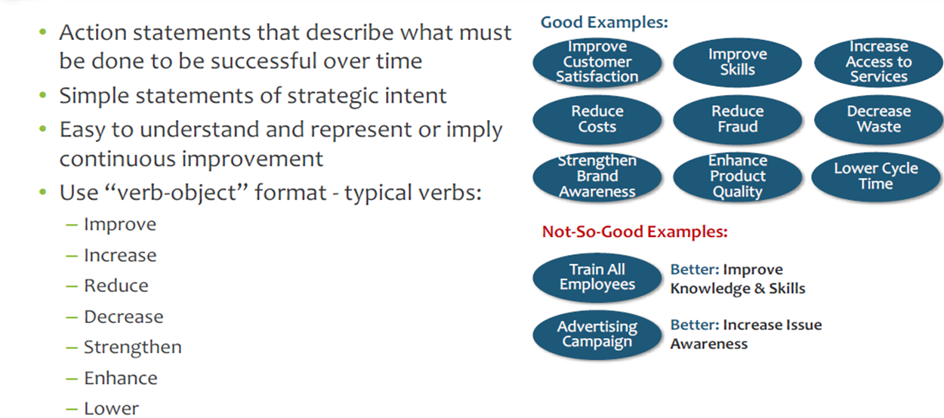
Characteristics of Good Strategic Objectives

Slide 22
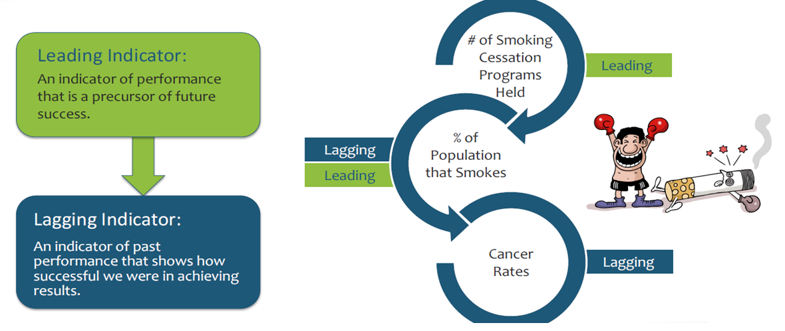
KPIs Can Be Leading or Lagging

Slide 23
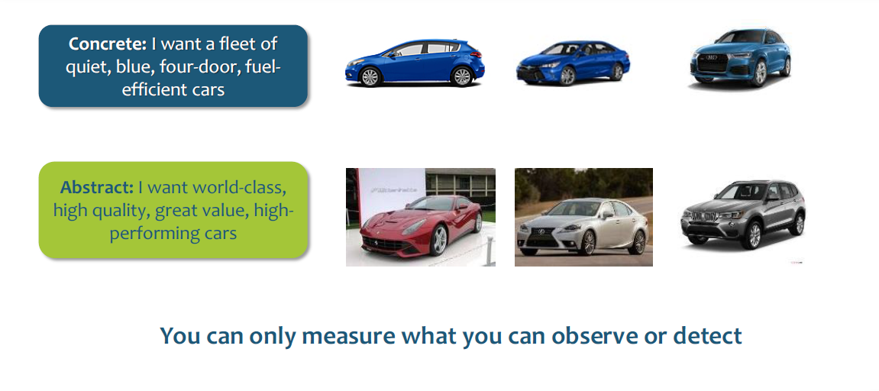
Concrete Language Is More Memorable and Measurable

Slide 24
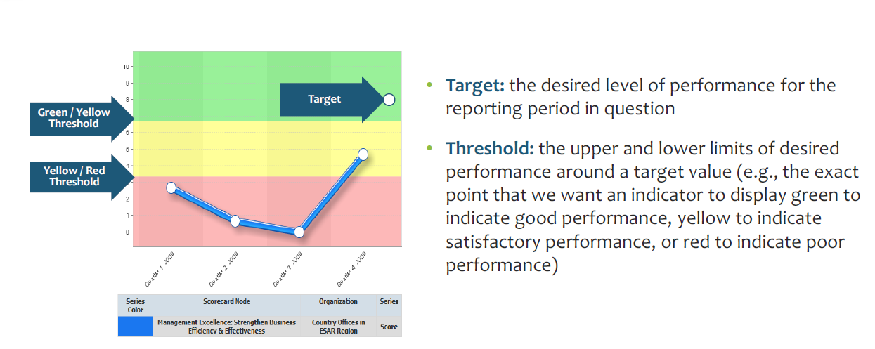
Targets & Thresholds

Slide 25
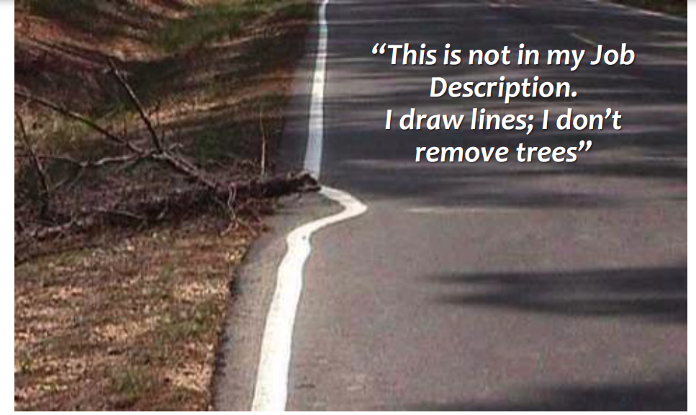
Change Management Sometimes Means Changing the Culture

Slide 26

Thank You
Questions

