Slide 1
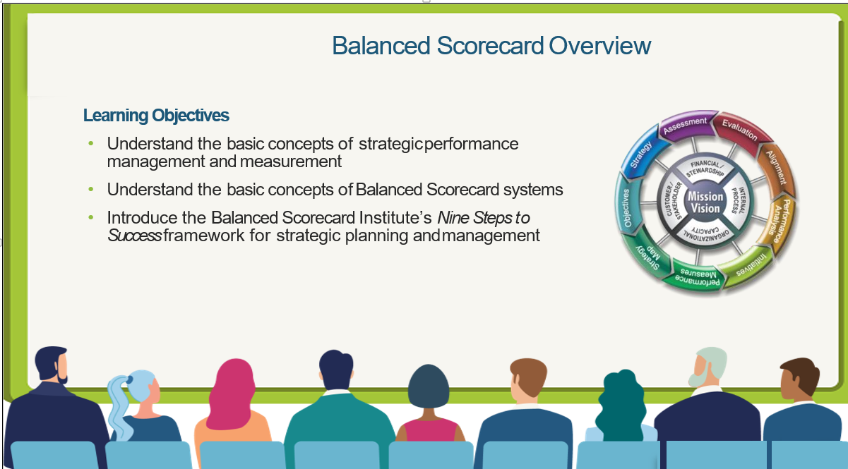
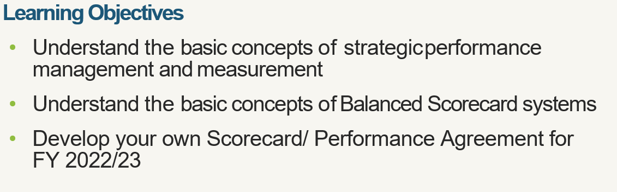

Slide 2

ABOUT PROACT INTERNATIONAL
Founded in 2004 as a conference organizing, training and consulting multinational institution.
Global operations in Africa, Asia, Europe, North America, South America, and Australia.
Great team of experts
The ability to bring you the world’s best consultants ensures you get unmatched quality.
We are committed to your success for your success is our mission

Slide 3





ProAct International is the local chapter and authorized training provider for:
  The HR Certification Institute (HRCI- USA)
  PECB University – Washington DC
  The Global Academy of Finance and Management (GAFM)
  The American Academy of Project Management
We offer a wide range of professional courses, charters, memberships and certifications that are accredited by the International Accreditation Service® IAS®. Our Professional programs are also ISO/IEC 17024, ISO 9001:2008 Certified for Quality and ISO 29990:2010 Certified for Educational Standards.
The International Organization for Standardization, which publishes the ISO/IEC standards, is the world’s largest developer of international standards, including those for certifying organizations that confer our credentials.

Slide 4
What we offer:
  Advanced Leadership and Management Training Programs and Consultancy
  Governance and Risk Management Training Programs and Consultancy
  Strategy Development and Management Training Programs and Consultancy
  Organizational Development and Capacity Assessment
  Human Resource Management Training Programs and Consultancy
  Finance, Accounting and Budgeting Training Programs and Consultancy
  Forensic Auditing Training Programs and Consultancy
  Project Management Training Programs and Consultancy
  Procurement, Logistics & Supply Chain Management Training Programs and Consultancy
  Training Programs for Secretaries, PAs, EAs, Office Administrators and Support Staff

Slide 5
Some of our acclaimed professional programs:
  CIBSCP Certified International Balance Scorecard Professional™
  CIOEP™ Certified International Organizational Excellence Professional™
  GPHR™ Global Professional in Human Resources™
  SPHRi™ Senior Professional in Human Resources – International™
  CHRA™ Chartered Human Resource Analyst™
  CHRBP™ Chartered Human Resource Business Partner™
  CLP™ Certified Leadership Professional™
  CIPM™ Certified International Project Manager™
  CHE™ Chartered Economist - Professional Program™
  CMP™ Certified Management Professional™
  CIPM™ Certified International Project Manager™
  CITA™ Certified International Tax Analyst™
  CRA™ Chartered Risk Analyst™
  ISO/IEC 27002 Manager -Information Security Controls
  ISO/IEC 27032 Cybersecurity Manager
  ISO/IEC 38500 IT Corporate Governance Manager
  ISO 9001 Lead Quality Management System Implementer
  ISO 45001 Occupational Health and Safety Management Systems (OH&S MS) Implementer
  ISO 30301 Records Management System Lead Implementer
  ISO 14001 Lead Environmental Management Systems Auditor/ implementer
  ISO 50001 Energy Management Systems Implementer
  ISO 10004 Customer Satisfaction Manager
  ISO 21500 Lead Project Manager

Slide 6

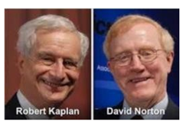
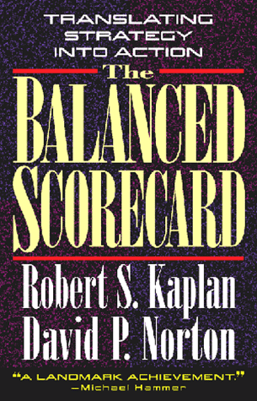

The Balanced Scorecard (BSC) - "One of the most important management practices of the past 75 years"
Enterprise-wide Strategic Management
Measurement and Reporting
Alignment and Communication
1992
2022
Articles in Harvard Business Review:
  “The Balanced Scorecard — Measures that Drive Performance” January - February 1992
  “Putting the Balanced Scorecard to Work” September - October 1993
  “Using the Balanced Scorecard as
  a Strategic Management System” January - February 1996
Endorsement by Gartner Group 2009:
The balanced scorecard methodology
developed by Drs. Kaplan and Norton
extends beyond financial measures to
link vision to action.
The Harvard Business Review has
acclaimed the balanced scorecard
as one of the most influential ideas
of the past 75 years
Source: Gartner Group; 2009 Feature Article:
Business Value of IT — Non-financial Measurements
“The Balanced Scorecard” is translated into 18 languages
Informed Risk Decisions
1996
2000
Based on presentation of Balanced Scorecard Collaborative

Slide 7
What is Balanced Score Card (BSC)?
An integrated strategic planning and performance management system
It’s a system that strikes a balance between all aspects of an organization
Financial and non-financial
Internal and External
Long term and Short term
Strategic Initiatives and Measures/ KPIs
Targets and Results
Lead and Lag (Predictive Vs Output)
Perspectives
Scorecard

Slide 8
Balanced Score Card…
Is a strategic management tool that helps us to bring our vision to life by;
Clarifying how we’re going to achieve our vision
Defining how we’re going to measure our progress
Enabling each of us to see how we contribute to our success

Slide 9
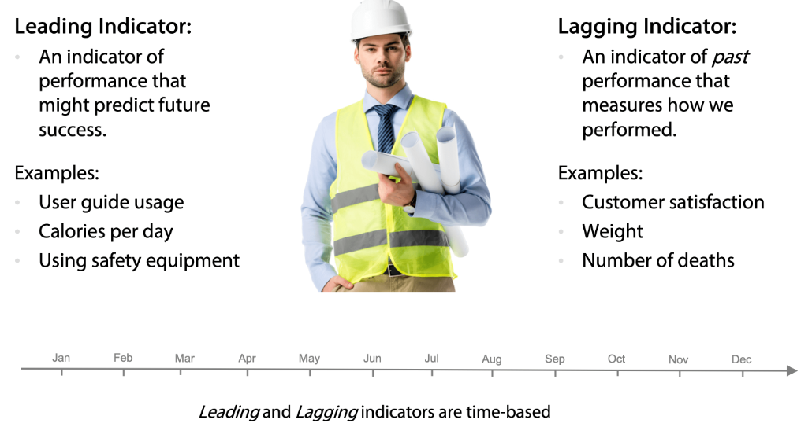
Leading and Lagging Indicators – Cause & Effect Chain
Lag – For Decision Making
Lead – For Performance Measurement
Discussion: What drives High Performance?

Slide 10
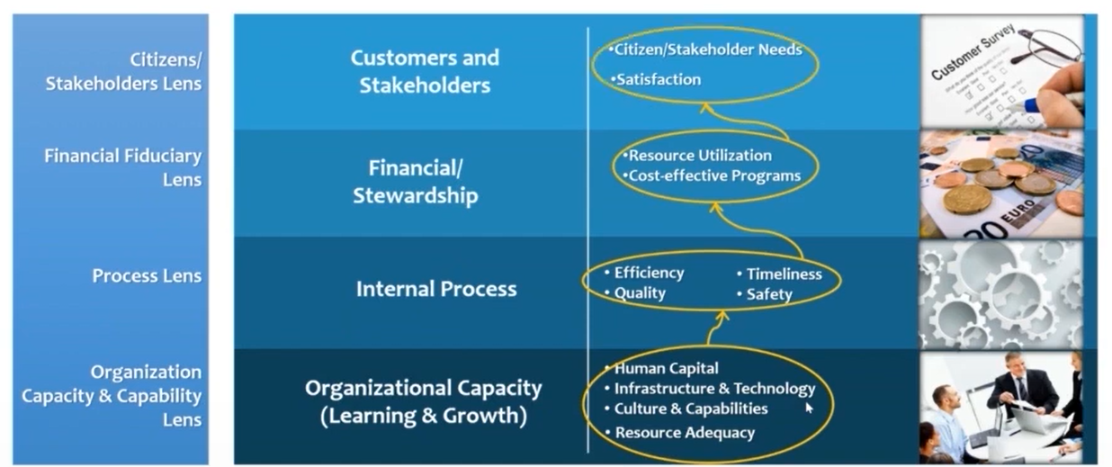
Scorecard Logic

Slide 11

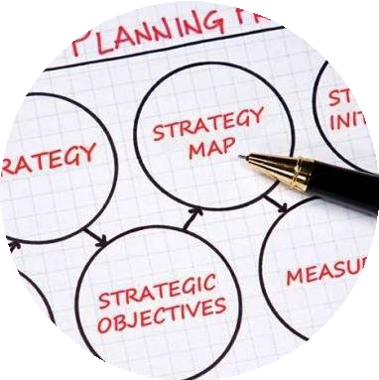

How does it help?...
Disruptions to strategy and operations
Stressed budgets requiring reprioritization
Revisions to Goals, Measures and Targets
New ways to work and meet client/ stakeholder needs
Key Drivers - Improved Quality of Life. Health, Education, Security, Environmental, other stakeholder outcomes
—a better life

Slide 12
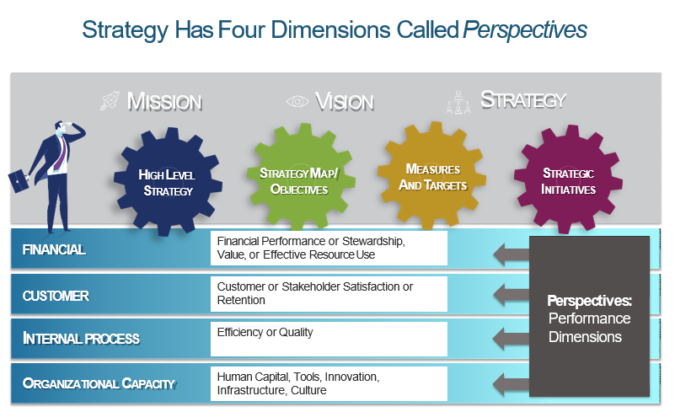

Slide 13
Role of BSC…
The Balanced Scorecard process allows an organization to align and focus all its resources on its strategy
STRATEGY
BUSINESS UNITS
EXECUTIVE TEAM
HUMAN RESOURCES
INFORMATION
TECHNOLOGY
BUDGETS AND CAPITAL INVESTMENTS

Slide 14
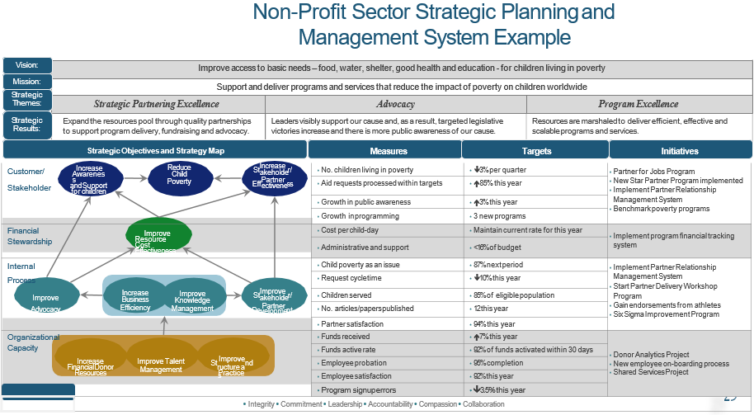

Slide 15
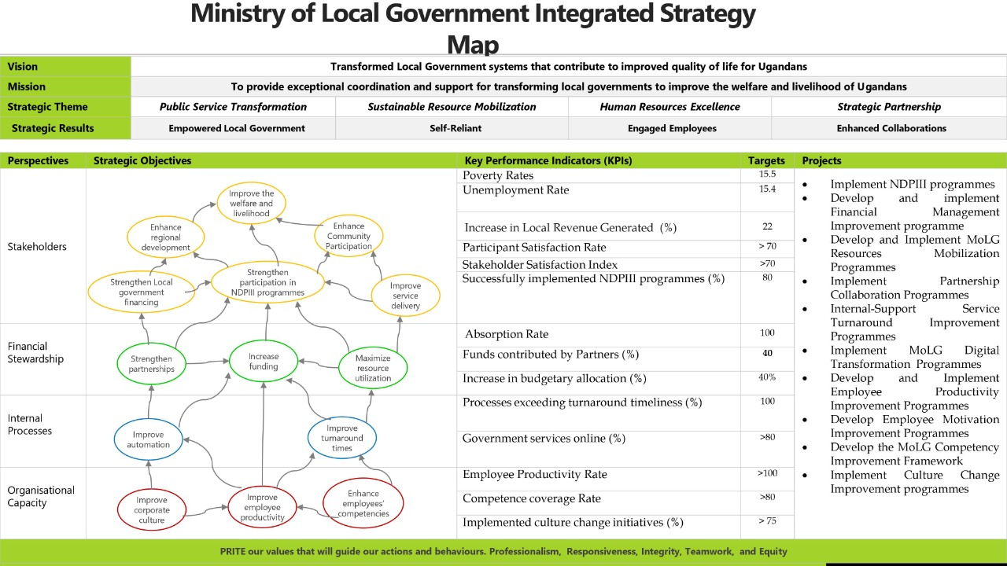

Slide 16
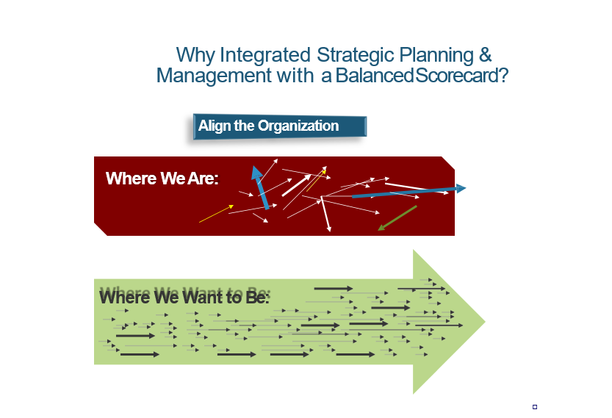

Slide 17


Slide 18
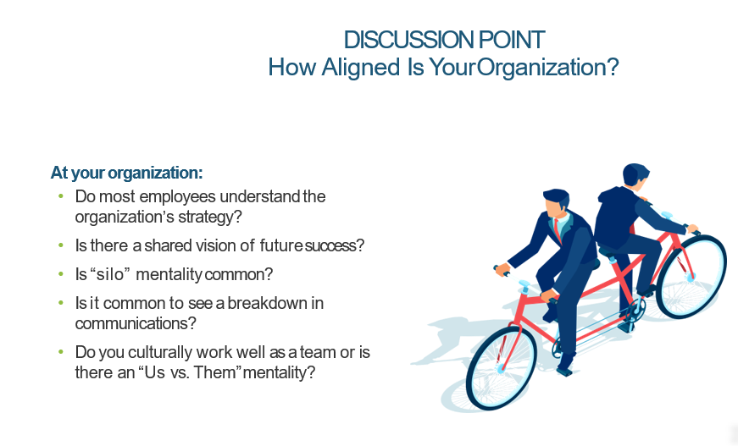

Slide 19
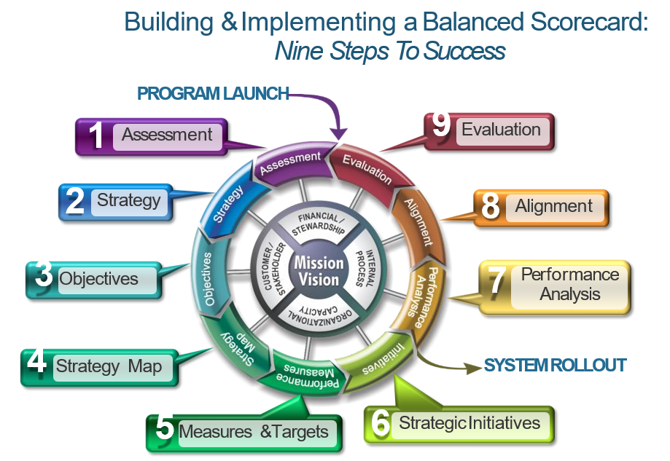
Why Balanced Scorecard?

Slide 20
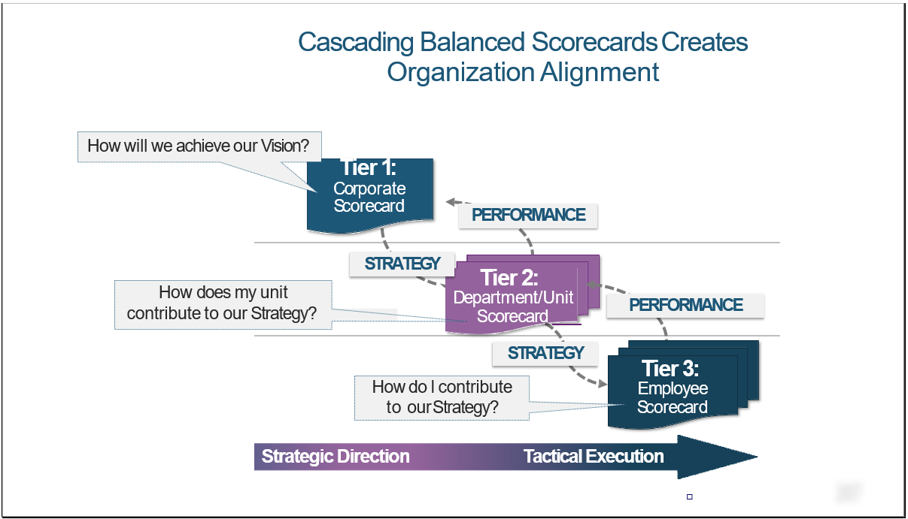

Slide 21
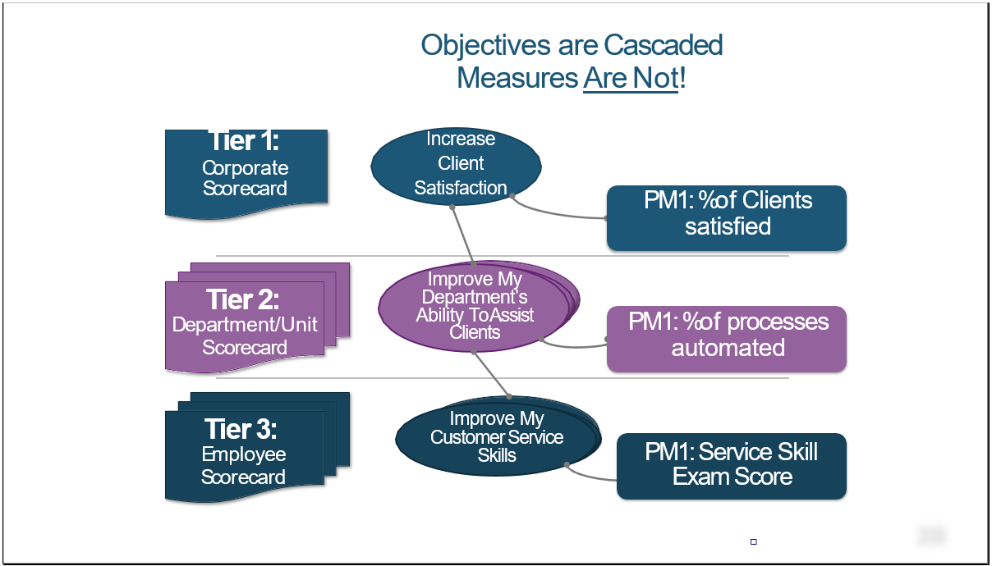

Slide 22

Ministry of Public Service (MoPS)-Uganda Strategy Map
Vision: A responsive and productive Public Service that promotes good governance for National transformation
Mission: To provide responsive human resource management systems that facilitate Public sector transformation
Strategic Pillars | Empowered workforce | Client Service Excellence |  | Operational Efficiency
Strategic Results | Highly satisfied and engaged employees, reduced turnover, high a performing workforce and transformed public service | Accessible, dependable, and error-free services, reduced complaints, high client satisfaction, high Public Trust, and a reputable image. |  | Technology Driven, integrated, standardized, innovative, risk-free processes and improved turnaround time
 | Strategic Objectives | KPIs | Targets (5year) | Strategic Initiative
Stakeholders & Clients |  | Client Satisfaction Index | 77 | Review and develop management and operational standards in the public service
 |  | Global competitiveness index | 55 | Implement the NDPIII programmes to transform public service
 |  | Governance Compliance Rate | 100 | Streamline Government structures and Governance systems
Financial Stewardship |  | Revenue Growth (%) | 15 | Implement Ministry a resources mobilization Strategies
 |  | Budget Absorption Rate | 100 | Implement a Budget management framework
Internal Business Processes |  | Government effectiveness Index | 0.01 | Decentralized service delivery for the Ministry
 |  | Client Charter Compliance Rate | 100 | Initiate programmes to make Ministry the centre of excellence in service delivery
 |  | Technology Adopted (%) | 100 | Automate Ministry service delivery systems and processes
 |  | Innovation implemented (%) | 75 | Institutionalize research and innovation in the Ministry
Organisational Capacity |  | Employee Satisfaction Index | 85 | Implement a total rewards and sanctions system for the Ministry
 |  | Competent employees (%) | 95 | Implement Talent management Framework
 |  | Cultural Infusion (%) | 70 | implement a mindset change and culture infusion programme for the Ministry
Core Values: Integrity-Professionalism-Client focus-Innovativeness
Transform Public Service
Enhance Client satisfaction
Strengthen governance capacity
Mobilise resources
Increase budget absorption
Increase Government effectiveness
Enhance innovation
Increase technology adoption
Improve turnaround time
Enhance employee engagement
Improve Ministry culture
Strengthen employee competences

Slide 23
Ministry of Local Government Integrated Strategy Map
Vision | Transformed Local Government systems that contribute to improved quality of life for Ugandans
Mission | To provide exceptional coordination and support for transforming local governments to improve the welfare and livelihood of Ugandans
Strategic Theme | Public Service Transformation | Sustainable Resource Mobilization | Human Resources Excellence | Strategic Partnership
Strategic Results | Empowered Local Government | Self-Reliant | Engaged Employees | Enhanced Collaborations
Perspectives | Strategic Objectives | Key Performance Indicators (KPIs) | Targets | Projects
Stakeholders |  | Poverty Rates | 15.5 | Implement NDPIII programmes Develop and implement Financial Management Improvement programme Develop and Implement MoLG Resources Mobilization Programmes Implement Partnership Collaboration Programmes Internal-Support Service Turnaround Improvement Programmes Implement MoLG Digital Transformation Programmes Develop and Implement Employee Productivity Improvement Programmes Develop Employee Motivation Improvement Programmes Develop the MoLG Competency Improvement Framework Implement Culture Change Improvement programmes
 |  | Unemployment Rate | 15.4
 |  | Increase in Local Revenue Generated (%) | 22
 |  | Participant Satisfaction Rate | > 70
 |  | Stakeholder Satisfaction Index | >70
 |  | Successfully implemented NDPIII programmes (%) | 80
Financial Stewardship |  | Absorption Rate | 100
 |  | Funds contributed by Partners (%) | 40
 |  | Increase in budgetary allocation (%) | 40%
Internal Processes |  | Processes exceeding turnaround timeliness (%) | 100
 |  | Government services online (%) | >80
Organisational Capacity |  | Employee Productivity Rate | >100
 |  | Competence coverage Rate | >80
 |  | Implemented culture change initiatives (%) | > 75
PRITE our values that will guide our actions and behaviours. Professionalism, Responsiveness, Integrity, Teamwork, and Equity
Improve the welfare and livelihood
Enhance regional development
Enhance Community Participation
Strengthen Local government financing
Strengthen participation in NDPIII programmes
Improve service delivery
Strengthen partnerships
Increase funding
Maximize resource utilization
Improve automation
Improve turnaround times
Improve corporate culture
Improve employee productivity
Enhance employees’ competencies

Slide 24

Integrated Strategy Map
Vision | A Prosperous, Productive and Healthy population by 2040
Mission | To provide high quality and coordinated services to the community by focusing on both national and local priorities
Perspectives | Strategic Objectives | Key Performance Indicators (KPIs) |  | Initiatives
Stakeholders |  | Poverty Rates | 25 | Agro – Industrialization programmes
 |  | Share of working population (%) | 43 | Private Sector Capacity drive
 |  | Population growth rate (%) | 2.93 | Environment, Climate Change and Natural Resource Management Programmes
 |  | Change in Agricultural production Volumes (%) | 42 | Human Capital Development and Social Protection Programmes
Financial Stewardship |  | Currency (Ugx) | 0.255B | Budgeting and resource mobilization Plan
 |  | Currency (Ugx) | 5B | Local Revenue enhancement plan
 |  | Resources utilization (%) | 100 | Public resources utilization plans
Internal Processes |  | Turnaround Satisfaction Rate | >80 | Development Plan Implementation
 |  | Services Digitized (%) | 100 | Implement Electronic Revenue systems
 |  | Local Government Performance Rank | Top 10 | Governance and Security strengthening Initiatives
Organisational Capacity |  | Employee Engagement Index | >80 | Implement Rewards and Sanction systems
 |  | Competent Employee (%) | >90 | Implement Capacity building programmes
 |  | Employee net promoter score (eNPS) | >9 | Behavioral and Mindset Change
 |  | Governance Compliance Rate | 100 | Governance Improvement programmes
Core Value (APITIC) : Accountability-professionalism-integrity-teamwork-inclusiveness And Client Focus
Improve the Quality of Life
Reduce Poverty
Increase Household Incomes
Enhance value addition
Maximize resources utilization
Increase Central Govt Funds
Increase local revenues
Improve turnaround time
Strengthen decentralization system
Digitize District services
Improve employee Engagement
Strengthen employee competencies
Strengthen Governance system
Transform Corporate Culture

Slide 25


Entebbe Municipality Council Integrated Strategy Map
Vision | A model self-sustaining municipality with a prosperous people by 2040
Mission | To ensure sustainable service delivery to the satisfaction of the people of Entebbe
 | Strategic Objectives | Key Performance Indicator | Targets | Strategic Initiatives/Projects
Stakeholders |  | Reduced Poverty rates annually | 1.5 | Implement 100% of NDP programmes targeting the municipality in MDP
 |  | Reduction of households dependent on subsistence agriculture annually (%) | 3 | Implement 100% Agro-industrialization programmes in MDP
 |  | Crop and animal products value added annually (Million Tons) | 5 | Implement 100% Value addition initiatives in MDPP
 |  | Jobs created by the Industrial sector annually (%) | 8 | Implement 100% Private sector initiatives in the MDP
Financial Stewardships |  | Increase in central government transfer annually (%) | 10
 |  | Increase in Local government |  | Local revenue enhancement programmes
 |  | New Donors/Funders annually (%) | 50% | Develop and Implement Resource Mobilization strategies
 |  | Budget Absorption rate annually | 100
Internal Processes |  | Increase of Government effectiveness Index annually | 0.124 | Public sector Transformation
 |  | Turnaround Time delays reduced annually (%) | 100 | Develop or update Client Charter Service Standards
 |  | Improved municipal government processes annually (%) | 100 | Undertake Process mapping
 |  | Digitalize government service annually (%) | 100 | Develop or Update Government Digitalization initiatives
Organisational Capacity |  | Increase in employee engagement index annually | >5 | Implement a reward management system
 |  | Increase in employee skills and knowledge (%) | >10 | Implement an annual training programme
 |  | Annual Employee Net Promoter Score (EnPS) | >9 | Implement Municipality Culture change initiatives
 |  | Municipality Governance Compliance Rate annually | 100% | Implement Governance Improvement programmes in MDP
Core Value : Effectiveness, efficiency, Transparency, accountability and Integrity
Increase Household Incomes
Improve the Quality of Life
Strengthen the private sector
Enhance value addition
Increase central government funds
Mobilize Resources
Maximize resources utilizations
Increase local revenue
Deepen decentralization
Improve municipal government processes
Improve turnaround time
Digitalize government service
Improve employee engagement
Improve municipality culture
Strengthen employee skills and knowledge
Strengthen municipality governance

Slide 26

Mbale City Integrated Strategy Map
Vision | An Attractive, Wealthy and Liveable City of Enterprising Citizens
Purpose | To Provide exceptional public service, facilities and opportunities that create, sustain, and enhance the safe, wealthy and liveable diverse communities Of Mbale City
Perspectives | Strategic Objectives | Key Performance Indicators (KPIs) | Targets | Strategic Initiatives
Stakeholders |  | Increase in Citizen Satisfaction Index annually | >5 | Implement Client Service Standards
 |  | Increase in the household incomes annually (%) | >5 | Implement the NDP programme for the City
 |  | Reduction in poverty rate annually | >1 | Implement the NDP programme for the city
 |  | Increase in value-added products annually (%) | >15 | Implement the NDP programme for the City
Financial Stewardship |  | Increase in central government funds annually (%) | 10 | Implement Budgeting and Lobbying framework
 |  | Increase in local revenue annually (%) | >10 | Implement Local revenue enhancement Plan
 |  | Funds use absorption rate | 100
 |  | Increase in donor/partners resources annually (%) | >10 | Implement Resource mobilization Plan
Internal Processes |  | Increase in enhanced turnaround time annually (%) | >100 | Develop or Update Service standards and Map all processes
 |  | Increase in digitized city services annually (%) | >100 | Implement City Digitization Master Plan
 |  | Increase in innovations implemented annually (%) | >75 | Implement the City Innovation improvement framework
 |  | Local Government Performance Rank | Top 5 | Make Local government reaches every Mbale City Citizen
Organisational Capacity |  | Employee Net Promoter Score (eNPS) | >9 | Develop and Implement City Culture Transformation Programme
 |  | Increase in staff satisfaction index annually | >5 | Implement reward system
 |  | Increase in employee competencies coverage annually (%) | >10 | Implement City Competency Improvement Framework
 |  | Annual Governance Compliance Rate | 100 | Implement Local Governance systems
Core Value: Integrity, Teamwork, Professionalism, Inclusiveness, Equity
Increase citizen satisfaction
Improve the quality of life
Increase the household incomes
Improve Value addition
Maximize absorption of Funds
Grow local revenue
Increase Central Government funds
Mobilize donor/Partners resources
Enhance service turnaround time
Deepen decentralization
Strengthen innovations
Digitize city services
Strengthen employee competencies
Improve staff satisfaction
Transform Corporate Culture
Enhance governance systems

Slide 27

DNA of Strategy System
Because so many other critical components—strategy mapping, performance measures and targets, and strategic initiatives—are derived from them, strategic objectives are considered the DNA of the Balanced Scorecard system.
Chaining of objectives to form a strategy map

Slide 28
BSC Terminology
Strategic Theme:
Diagram of the cause-and-effect relationships between strategic objectives
Strategic Theme:
Customer Service Excellence
Objectives
Statement of what strategy must achieve and what’s critical to its success
Measures
How success in achieving the strategy will be measured and tracked
Targets
The level of performance or rate of improvement needed
Initiatives
Key action programs required to achieve objectives
Stakeholders
Reduce Poverty
Enhance Value addition
Financial
Increase local Revenue
Internal
Objectives
KPIS/Measures
Targets
Initiatives
Improve business processes
Increase Local Revenue
Increase in local revenue annually (%)
>10
Local revenue enhancement Plan
Reduce process delays
Reduce process errors
Capacity
Improve employee skills
Notes:
Levels of Strategic objectives

Slide 29
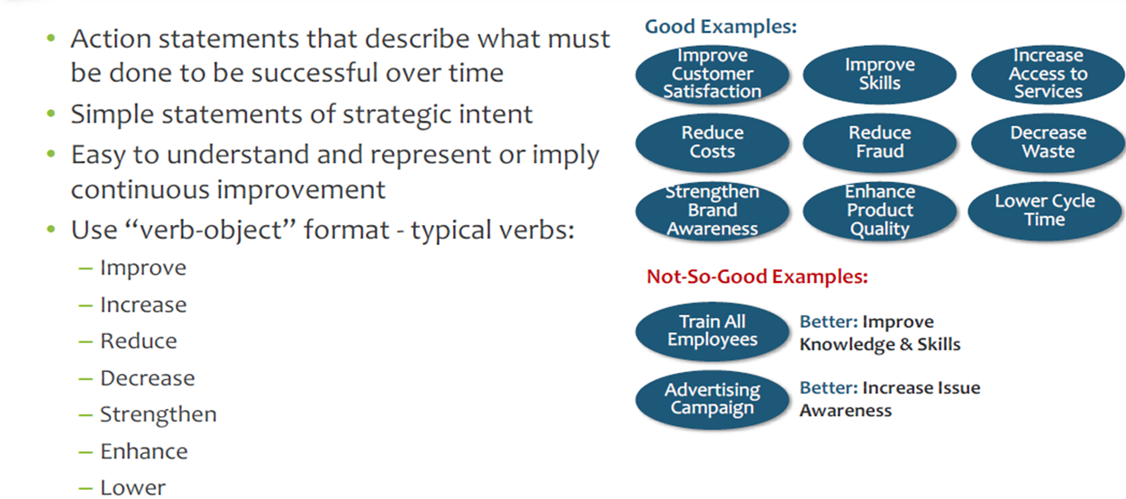
Characteristics of Good Strategic Objectives

Slide 30

Avoid the following Mistakes when developing objectives
Including too much detail in objectives
1
“Automate the Billing Process to Reduce Costs by 20 percent” may seem like a simply-written objective, but the thought actually contains multiple strategic elements.
Confusing organization structure and functions with strategic objectives
2
Improve Human Resources
Strengthen Information Technology Department
Using objectives that are too generic
3
“Increase Revenue” or “Increase Knowledge”
Better Increase revenue in Target market
Use more descriptive words that capture the intent of the business

Slide 31
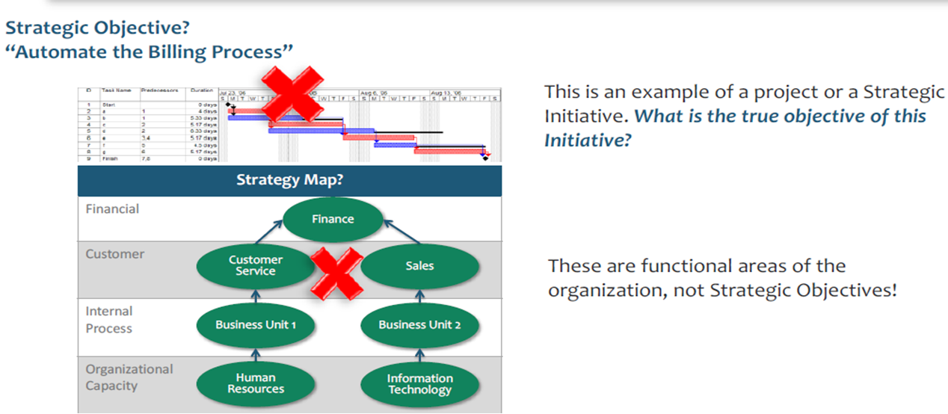
Objectives are Not Projects that Start and Stop or Organizational Functions

Slide 32
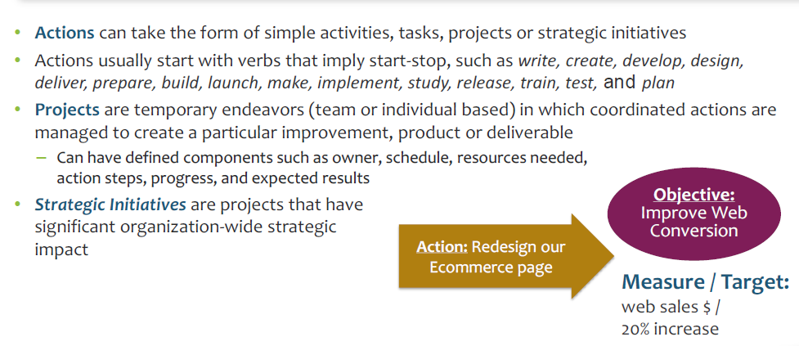
Actions and Projects Are a Means to An End, Not the End Itself

Slide 33
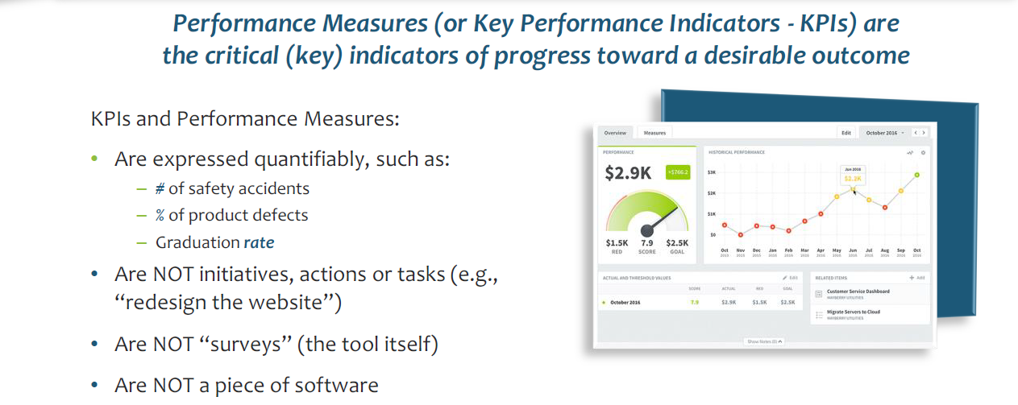
Performance Measure (KPI) Definition

Slide 34
Common Measurement Challenges
Key Performance Indicators (KPIs) are not linked to the results that the organization wants to achieve -- KPIs focus on inputs and activities, not outputs and outcomes
KPIs are lagging (after the fact) indicators that don’t give much guidance on where the organization is headed or should head
No ownership or accountability is attached to performance measures
KPIs are selected because they are easy to count — e.g., number of citizens served, number of potholes filled, number of inspections
KPIs are picked because “everybody uses these”

Slide 35
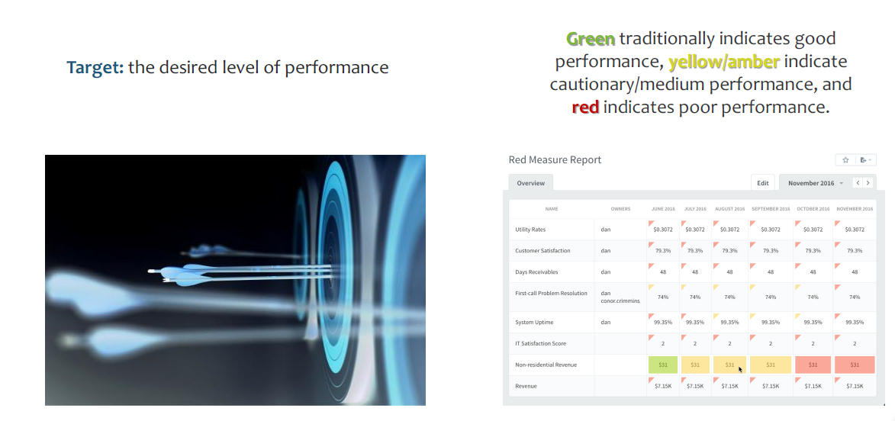
KPIs Can Be Interpreted Using Targets & Colour Coding

Slide 36
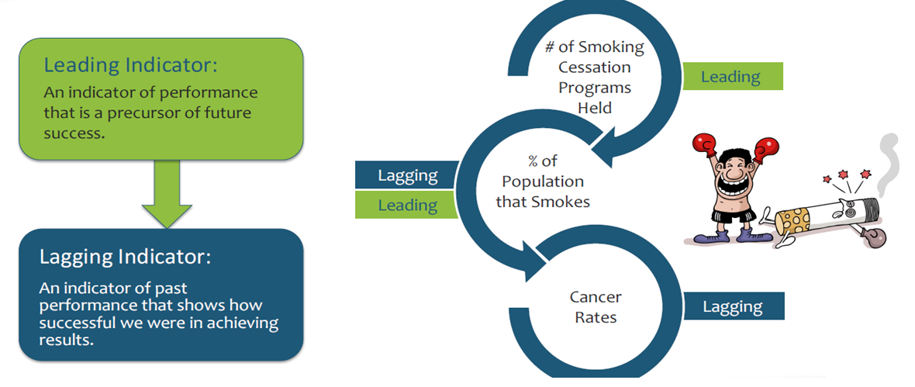
KPIs Can Be Leading or Lagging

Slide 37
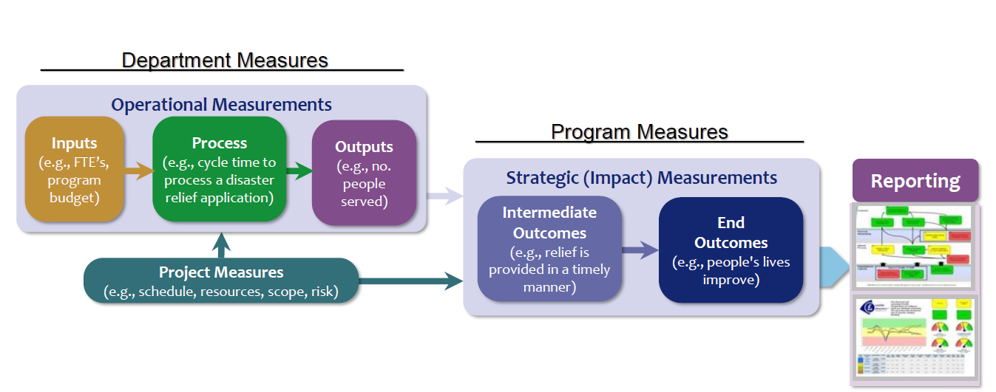
Business Intelligence Value of Different
Types of Performance Measures

Slide 38
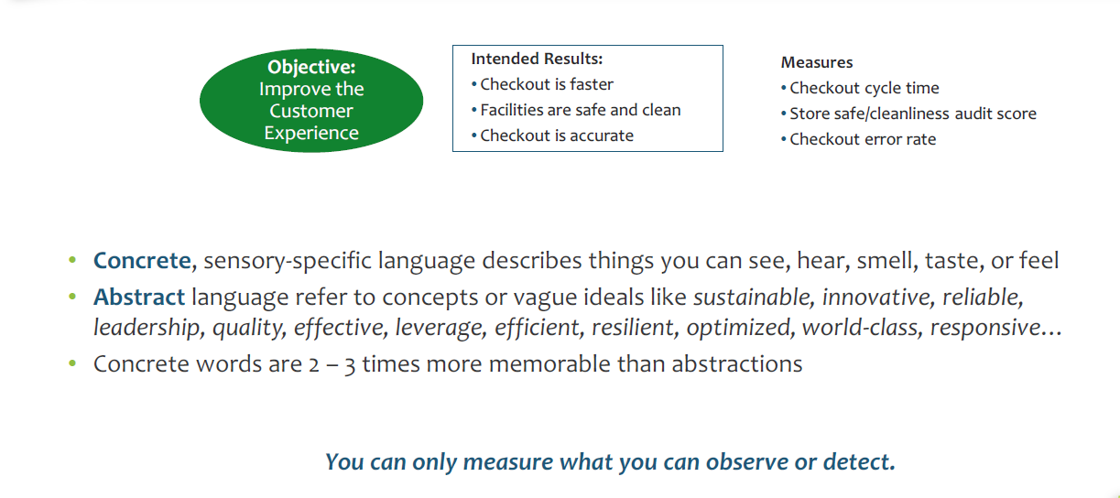
Write Intended Results Using Concrete Language

Slide 39
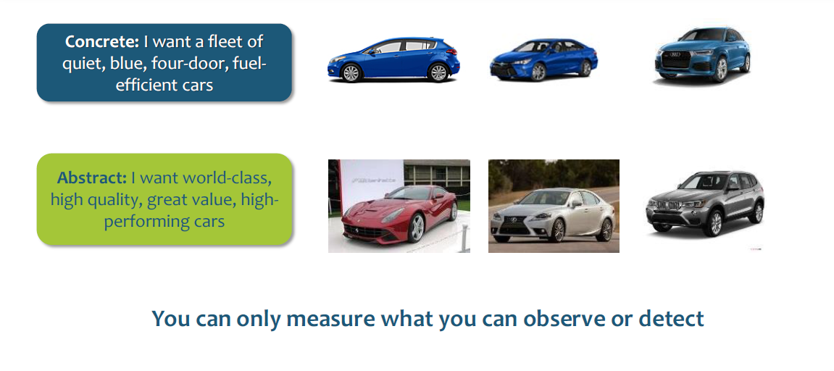
Concrete Language Is More Memorable and Measurable

Slide 40
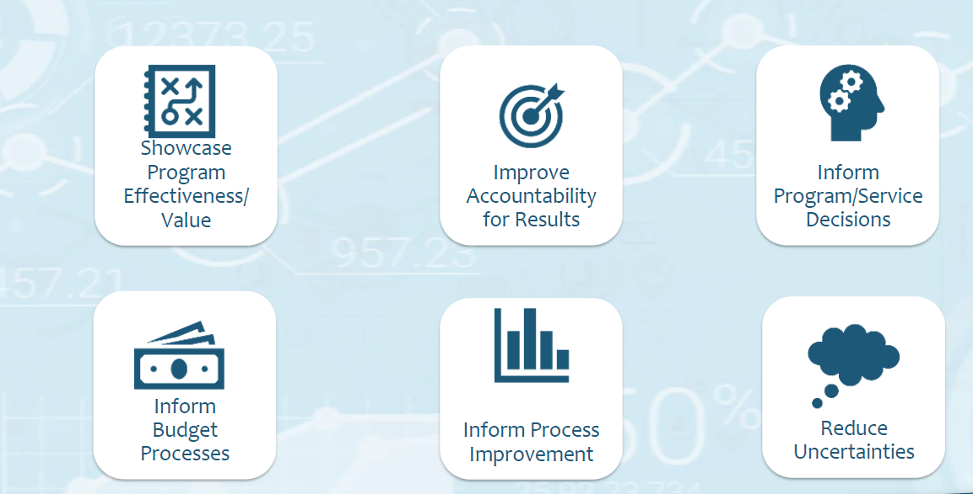
Measurement Systems Support Many
Government / Public Sector Needs

Slide 41
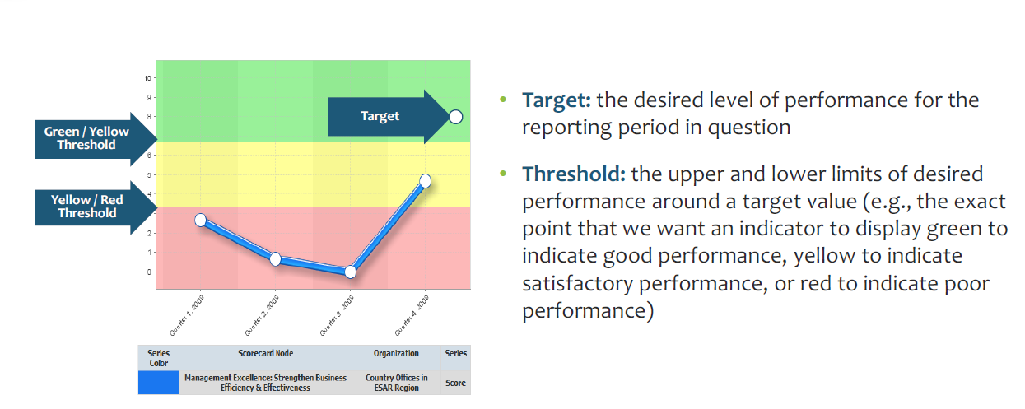
Targets & Thresholds

Slide 42
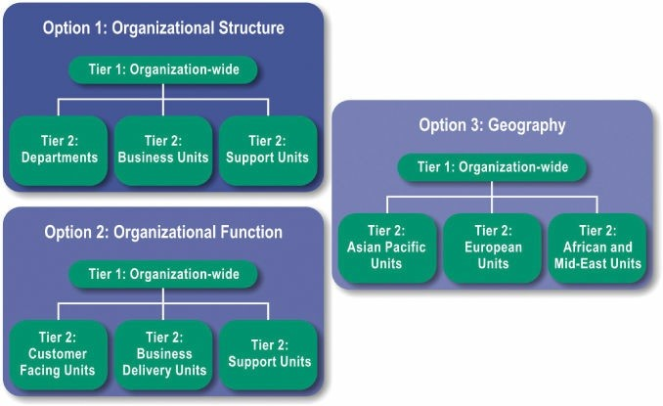
Select the Cascading Approach
There are three approaches for cascading to business and support units which can be combined to create a custom solution for any organization type:
By organizational structure, which follows the enterprise’s existing hierarchies and divisional/departmental relationships, displayed in an organization chart
By function, which groups units into work-related categories, such as customer-facing units, delivery units, production units or support units
By geography, which creates groups based on location, such as international regions
Notes:
Alignment is when organizational structures, processes and systems support the strategy of the organization.
An organization is strategically aligned when all employees understand what the organization is trying to accomplish, make decisions and take actions based on that strategy, and align department and individual goals with higher level goals.
Alignment is created when high-level strategy is cascaded first to business and support units and then to individual employees.
This step continues the change management process started in the Assessment Step.
New teams are formed to construct the aligned scorecards, bringing new employees into the strategic thinking process.

Slide 43
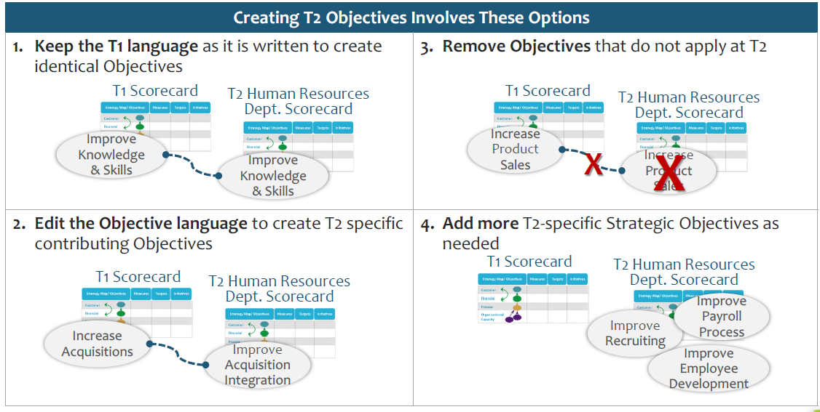
Cascading Objectives From T1 to T2

Slide 44
Experience from Mukono District, Entebbe Municipality and Mbale City
District/City/Municipal Development Plans-Unbalanced
Strategic Agenda-minimal in key meetings
Communicating the strategy
Duration for completion of the assignment
Leadership Commitment
Resources prioritization
Passionate Change Agent
Focus on Operation
Incentives focus only on salaries
Performance information analysis
Cascading skills
Performance treated as separate activity

Slide 45
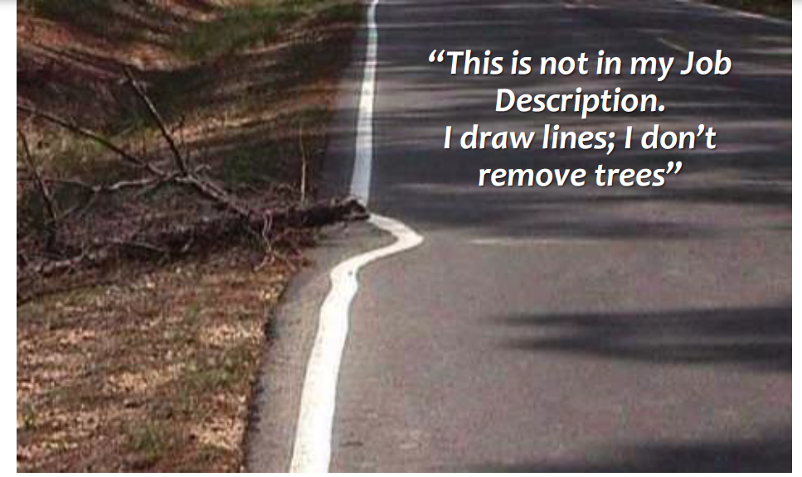
Change Management Sometimes Means
Changing the Culture

Slide 46

Thank You
Questions

