Slide 1
Local Government Management of Service Delivery (LGMSD)
Performance Assessment 2022
Highlights of the Results
Presentation to the Fiscal Decentralization Technical Committee
7th February, 2023

Slide 2
Presentation Outline
Part A: Introduction
Part B: Highlights of Results from the LGMSD exercise conducted in October- December 2022
Part C: Next Steps and Prayer

Slide 3
Part A: Introduction

Slide 4
Introduction: Scope of the LGMSD Assessment
The assessment of Local Government Management of Service Delivery has two elements:
Minimum Conditions (Core performance indicators) which focusses on key bottlenecks for service delivery and safeguards management.
Performance Measures (Departmental assessments); used to evaluate service delivery in the Districts/Municipalities as a whole, and for some areas aggregating performance information from facilities and Lower Local Governments (LLGs) and assessing compliance with performance reporting and improvement support.
Note:
If all MCs are met, then the final score for a LG will be equal to the score from the PMs
Every MCs not met reduces the final score of the LG
If all MCs are not met, then the final score is 0 irrespective of the PM score. Therefore, LG forfeits the performance component of the grant.
154 Local Governments (135 DLGs and 19MLGs) were assessed in the 2022 OPM assessment.
The other 10 Cities and 12 MLGs under USMID were assessed for only Health and Education Measures by a separate independent firm; making it 176 Local Governments.

Slide 5
Introduction: Overview of the LGMSD 2022 Process
Aspect | Process detail
Timing | The LGMSD was conducted from October to December 2022
Assessment Teams | OPM & MoFPED contracted 4 firms, one per Cluster: (i) ABS Consulting (Northern); (ii) UPIMAC (Eastern); (iii) Pazel Conroy (Western); and (iv) PROMOTE (Central) USMID LGs were assessed by KPMG
IVA Teams | OPM contracted Eficon to conduct Quality Assurance In addition, the process was closely monitored by the LGPA Task Force through spot checks in 40 LGs.
Reporting & Harmonization of Results | Individual LG specific reports were submitted on OPAMS via https://otims.finance.go.ug A Taskforce meeting was held on 25th January, 2023 to harmonize results of the assessment and IVA firms

Slide 6
Introduction: Status of LGMSD 2022
Cluster | No. LGs Assessed | Assessment reports submitted to OPM | Spot Checks Conducted by LG PA Task Force | IVA Assessments completed (EFICON Consults Ltd)
Central (Promote UG Ltd) | 31 | 31 | 10 | 4
Eastern (UPIMAC East Africa) | 41 | 41 | 10 | 4
Northern (ABS Consulting) | 41 | 41 | 10 | 4
Western (Pazel Conroy) | 41 | 41 | 10 | 4
USMID LGs (KPMG) | 22 | 22 | 0 | 0
Total | 176 | 176 | 40 | 16

Slide 7
Part B: Assessment Findings

Slide 8
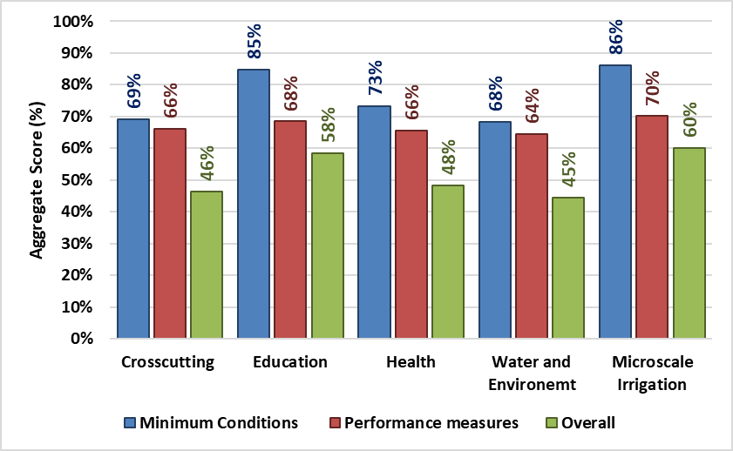
Overall Average Score Per Assessment Area for MCs and PMs

Slide 9
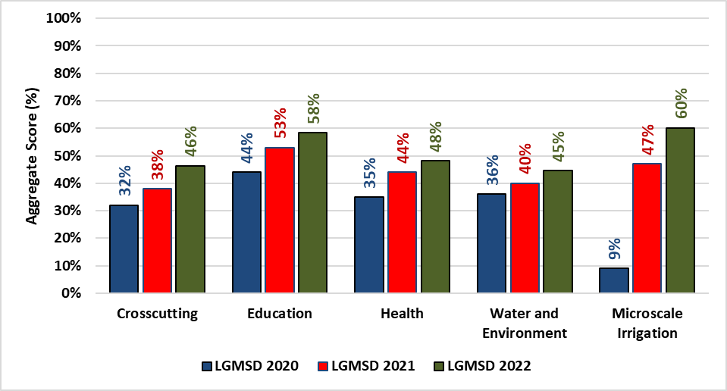
Trends in performance over the last three assessments: Overall Performance

Slide 10
Best & Worst 10 LGs under Crosscutting Assessment Area
A. Top 10 Performers
B. Worst 10 Performers
Rank 2022 | Vote | Score 2022
1 | Isingiro District | 90
2 | Ibanda District | 84
3 | Bushenyi District | 80
4 | Mayuge District | 76
5 | Sembabule District | 73
6 | Kiruhura District | 71
7 | Rubirizi District | 69
8 | Namayingo District | 67
8 | Lwengo District | 67
8 | Kamwenge District | 67
Rank 2022 | Vote | Score 2022
145 | Karenga District | 23
145 | Obongi District | 23
145 | Bugweri District | 23
145 | Buhweju District | 23
149 | Amuria District | 22
150 | Kapelebyong District | 21
151 | Nwoya District | 20
152 | Abim District | 19
153 | Ngora District | 18
154 | Namisindwa District | 8

Slide 11
Best & Worst 10 LGs under Education Assessment Area
A. Top 10 Performers
B. Worst 10 Performers
Rank 2022 | Vote | Score 2022
1 | Luuka District | 90
2 | Kamwenge District | 89
3 | Kiruhura District | 88
3 | Isingiro District | 88
5 | Ibanda District | 87
6 | Manafwa District | 86
6 | Kibuku District | 86
8 | Maracha District | 85
8 | Bukedea District | 85
10 | Kibaale District | 84
Rank 2022 | Vote | Score 2022
145 | Kisoro District | 25
146 | Butebo District | 23
147 | Kapelebyong District | 20
147 | Nakapiripirit District | 20
147 | Abim District | 20
150 | Kumi Municipal Council | 19
151 | Namisindwa District | 18
152 | Kween District | 10
153 | Kwania District | 0
153 | Kalaki District | 0

Slide 12
Best & Worst 10 LGs under Health Assessment
Area
A. Top 10 Performers
B. Worst 10 Performers
Rank 2022 | Vote | Score 2022
1 | Isingiro District | 95
2 | Kiruhura District | 92
3 | Ibanda District | 91
4 | Kamwenge District | 90
5 | Kibuku District | 83
6 | Maracha District | 79
7 | Mbarara District | 78
7 | Rubanda District | 78
9 | Namayingo District | 76
10 | Rukiga District | 75
Rank 2022 | Vote | Score 2022
145 | Kyotera District | 20
146 | Bukwo District | 19
147 | Ntoroko District | 18
148 | Pader District | 17
149 | Kalaki District | 16
150 | Kapelebyong District | 15
151 | Lamwo District | 13
151 | Bulambuli District | 13
153 | Nebbi Municipal Council | 11
153 | Bugweri District | 11

Slide 13
Best & Worst 10 LGs under Water & Environment Assessment Area
A. Top 10 Performers
B. Worst 10 Performers
Rank 2022 | Vote | Score 2022
1 | Mayuge District | 88
2 | Isingiro District | 84
3 | Gulu District | 80
4 | Sembabule District | 76
5 | Namayingo District | 71
6 | Mpigi District | 70
6 | Dokolo District | 70
8 | Kamwenge District | 69
9 | Kiruhura District | 68
10 | Zombo District | 67
Rank 2022 | Vote | Score 2022
125 | Buliisa District | 20
127 | Kapelebyong District | 19
128 | Kayunga District | 18
129 | Oyam District | 17
130 | Butambala District | 16
130 | Buvuma District | 16
132 | Amuria District | 13
133 | Obongi District | 9
134 | Mukono District | 7
135 | Ntoroko District | 4

Slide 14
Best & Worst 10 LGs under Microscale Irrigation Assessment Area
A. Top 10 Performers
B. Worst 10 Performers
Rank 2022 | Vote | Score 2022
1 | Kyegegwa District | 89
1 | Ibanda District | 89
3 | Mbale District | 85
3 | Luwero District | 85
5 | Butambala District | 83
6 | Wakiso District | 82
7 | Nakaseke District | 81
8 | Kamwenge District | 80
9 | Rukungiri District | 77
10 | Mityana District | 76
Rank 2022 | Vote | Score 2022
31 | Ntungamo District | 47
31 | Kamuli District | 47
33 | Luuka District | 31
34 | Mubende District | 26
35 | Mukono District | 25
36 | Kayunga District | 23
37 | Kitagwenda District | 21
38 | Masaka District | 20
39 | Bududa District | 18
40 | Amuru District | 0

Slide 15
Overall Composite/Combined Scores: Best & Worst 10 LGs
A. Top 10 Performers
B. Worst 10 Performers
Rank 2022 | Vote | Score 2022
1 | Isingiro District | 89
2 | Kiruhura District | 80
3 | Ibanda District | 79
3 | Kamwenge District | 79
5 | Mayuge District | 73
6 | Bushenyi District | 72
7 | Ibanda Municipal Council | 71
8 | Kibuku District | 69
9 | Bushenyi- Ishaka Municipal Council | 68
9 | Gulu District | 68
Rank 2022 | Vote | Score 2022
145 | Kween District | 30
146 | Serere District | 29
146 | Bugweri District | 29
146 | Kumi Municipal Council | 29
149 | Kwania District | 27
150 | Amuria District | 26
151 | Ntoroko District | 23
152 | Namisindwa District | 21
153 | Kapelebyong District | 19
153 | Kalaki District | 19

Slide 16
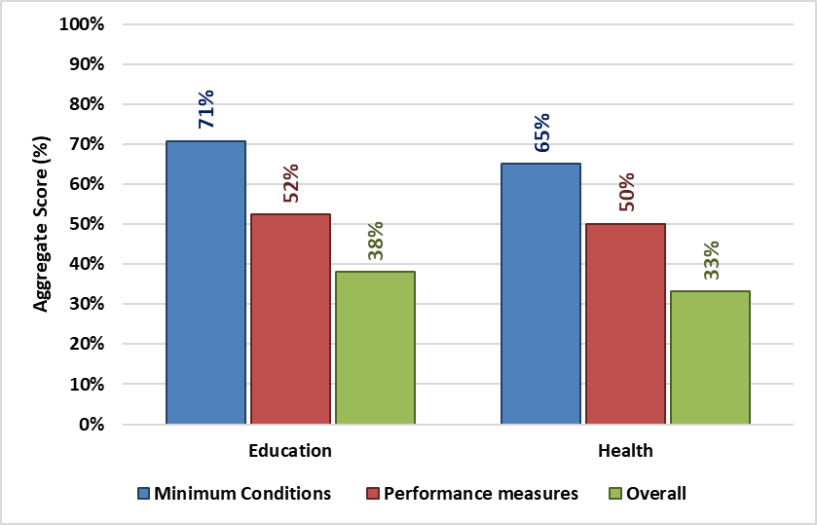
Overall Average Score Per Assessment Area for USMID Cities and MLGs
22 USMID LGs were assessed in the areas of Education and Health.
The overall performance was below average with 38% score under Education and 33% under Health.
The top 3 overall LGs are; Kabale MLG (73%), Mubende MLG (58%) and Apac MLG(49%).
The bottom 3 overall LGs are; Soroti City (19%), Tororo MLG and Moroto MLG each scoring 20% respectively.

Slide 17
Best & Worst Performance Indicators
A. Best Performance Indicators
% Score by all LGs | Indicator
100% | Mobilization activities for farmers conducted
100% | Education development grant spent on eligible activities
99% | Water infrastructure investments incorporated in AWP
99% | Water supply infrastructure projects approved by the CC
98% | Deployment of Teachers as per sector guidelines
98% | Audit opinion
98% | Up to-date LLG information entered into MIS
98% | LG visits to EOI farmers
98% | Awareness training on Micro-Scale Irrigation
97% | Teacher deployment list publicized
97% | Having complete Water project procurement Files
97% | Accuracy of information on WSS facilities constructed
97% | Budgeted and spent DDEG on eligible projects
97% | Accurate reports on Teacher deployment
96% | Timely submission of Annual Performance Contract

Slide 18
Best & Worst Performance Indicators cont’d…
B. Worst Performance Indicators
% Score by all LGs | Indicator
29% | Recruitment of LLG Ext. workers where wage is provided
28% | % of budgeted water projects implemented in sub counties below district average
28% | Recruitment of District/Principal Engineer
27% | Preparation of training plan for water staff
26% | Timely invoicing & communication of capitation grants to schools
25% | Appraisal of Secondary School Head Teachers
25% | Revenue collection ratio within +/- 10 of planned
25% | Health facility transfers publicized timely
19% | Timely submission of warrants for school’s capitation
18% | Timely warranting of direct DDEG transfers
18% | Timely submission of warrants for health facility transfers
16% | Invoicing & communication of DDEG transfers
16% | Recruitment of the Natural Resources Officer
15% | Timely invoicing & communication of health facility transfers
11% | Increase in functionality of WSCs

Slide 19
Findings from the LGPA Taskforce Spotchecks
The contracted firms deployed pre-qualified consultants to conduct the assessment exercise in all LGs
The LG PA teams complied with the timing and duration of the exercise (2 days) in all LGs
The LG PA team followed the sampling criteria and conducted field visits as prescribed in the assessment manual
The LG PA teams met all the relevant staff in all LGs
In all the LGs sampled for the spot checks, the level of professionalism for the LG PA team members was rated high (4.8/5 – 5 being the best)

Slide 20
Opinion by Independent Verification Agent (IVA)
An IVA (EFICON Consults Ltd) was contracted to verify the assessment process and the results
The firm sampled 16 LGs across the country as per the LGMSD manual
After reconciliation, the firm’s overall opinion is that the assessment exercise and results are valid, reliable and hence credible.

Slide 21
Outstanding issue:
Outstanding issue:
Results from the Lower Local Government Performance Assessment MAY NOT be used for allocation of DDEG to LLGs for FY 2023/24;
  Not all Local Governments undertook the LLG assessment (23 LGs failed to submit their results to OPM citing lack of resources to undertake the assessment on time)
  Following the budget cut and reallocation of DDEG funding to PDM, the envisaged reward system was tampered with.
The Taskforce therefore recommended that the LLG results for FY 2021/22 be used for Performance Improvement Plans and capacity building until the above issues are addressed.

Slide 22
Part C: Next Steps and Prayer

Slide 23
Next Steps and Indicative Timelines
Next Steps | Timelines (by)
The LGMSD results approved by the IGFTR Technical Committee (Detailed results attached) | February 7, 2023 (This meeting)
Use of the results to allocate development grants | February 13, 2023 (2nd BCC in Feb)
Dialogue with the respective Ministries and Agencies to discern emerging issues and recommendations | February and March, 2023
Produce the detailed National Synthesis Report | March, 2023
Dissemination of the LG PA results (websites, feed back to each of the LGs, inclusion in the Annual Performance Report (APR) of Government and a national dissemination event | April and May, 2023

Slide 24
Prayer:
To approve the results and adopt them for use in the grant allocations for fiscal year 2023/2024

Slide 25
Thank you!

