Slide 1

Step Three: Strategic Objectives

Slide 2
Step Three Tasks:
Develop
Develop Strategic Objectives for Strategic Themes
Create
Create Enterprise-wide Strategic Objectives from the Theme Objectives
Describe and Document
Describe and Document Strategic Objectives
Identify
Identify Objective Owners, Roles, and Responsibilities

Slide 3

DNA of Strategy System
Because so many other critical components—strategy mapping, performance measures and targets, and strategic initiatives—are derived from them, strategic objectives are considered the DNA of the Balanced Scorecard system.
Chaining of objectives to form a strategy map

Slide 4
BSC Terminology
Strategic Theme: Diagram of the cause-and-effect relationships between strategic objectives
Strategic Theme: Customer Service Excellence
Objectives
Statement of what strategy must achieve and what’s critical to its success
Measures
How success in achieving the strategy will be measured and tracked
Targets
The level of performance or rate of improvement needed
Initiatives
Key action programs required to achieve objectives
Financial
Grow Profits
Increase Revenue
Customer
Increase customer satisfaction
Internal
Objectives
Measures
Targets
Initiatives
Improve business processes
Reduce Process Errors
Error Rate
Less than 5%
Develop Six Sigma Programmes
Reduce process delays
Reduce process errors
Learning & Growth
Improve employee skills

Slide 5
Levels of Strategic objectives
At the corporate or enterprise level:
At the business and support unit (e.g., department) level:
At the individual employee level:
Notes:
At the corporate or enterprise level:
Strategic objectives identify the key continuous improvement activities that are necessary to be successful and accomplish the vision and achieve the mission.
At the business and support unit (e.g., department) level:
They identify the activities necessary to achieve departmental missions and support the enterprise and help define the strategy of the unit.
At the individual employee level:
Strategic objectives identify personal activities that create value and support the department’s mission.
Linking objectives at different levels to create alignment and accountability

Slide 6
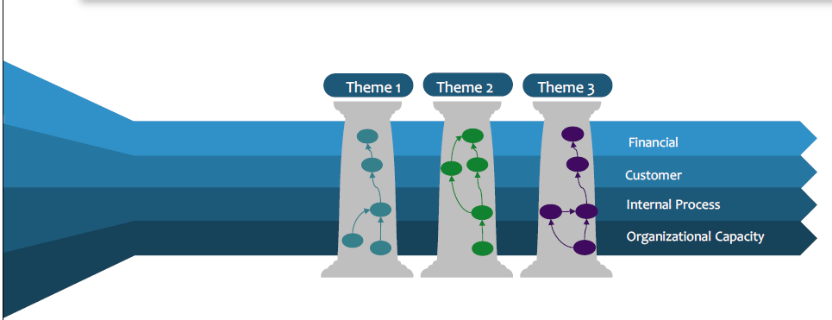
Task 1: Develop Strategic Objectives for Strategic Themes

Slide 7
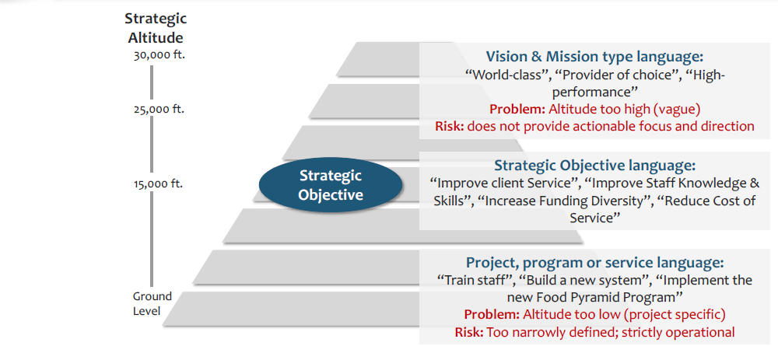
Strategic Objectives Are “Mid-altitude”

Slide 8
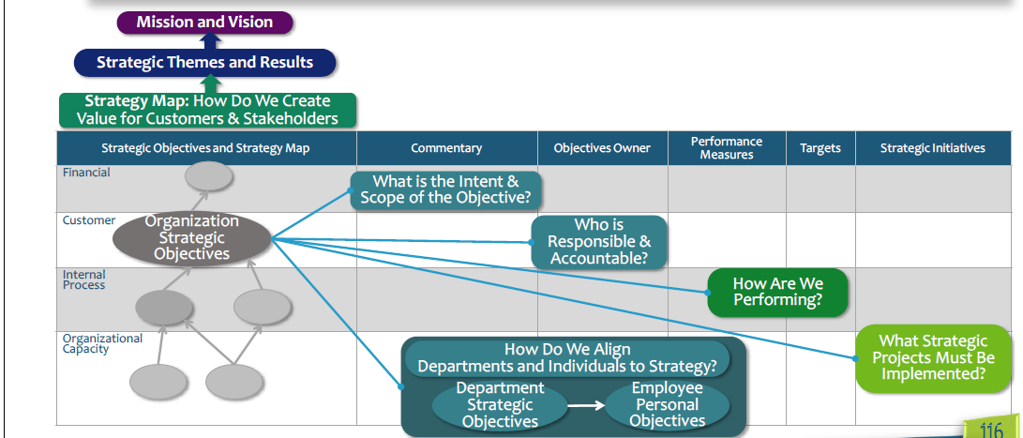
Objectives Connect Various Elements Of The Strategic Management System

Slide 9
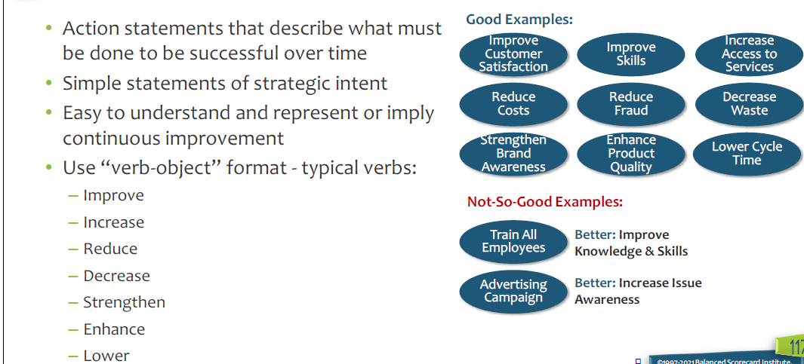
Characteristics of Good Strategic Objectives

Slide 10

Avoid the following Mistakes when developing objectives
Including too much detail in objectives
1
“Automate the Billing Process to Reduce Costs by 20 percent” may seem like a simply-written objective, but the thought actually contains multiple strategic elements.
Confusing organization structure and functions with strategic objectives
2
Improve Human Resources
Strengthen Information Technology Department
Using objectives that are too generic
3
“Increase Revenue” or “Increase Knowledge”
Better Increase revenue in Target market
Use more descriptive words that capture the intent of the business

Slide 11

When constructing objectives think about the outcome, not the department or unit the objective’s function falls into for organization reporting purposes
Put strategy in the language of the business, not in the language of a business school

Slide 12
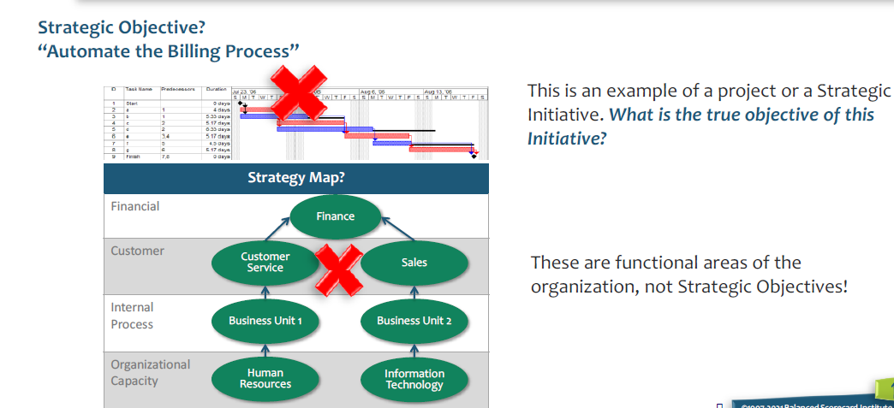
Objectives are Not Projects that Start and Stop or Organizational Functions

Slide 13
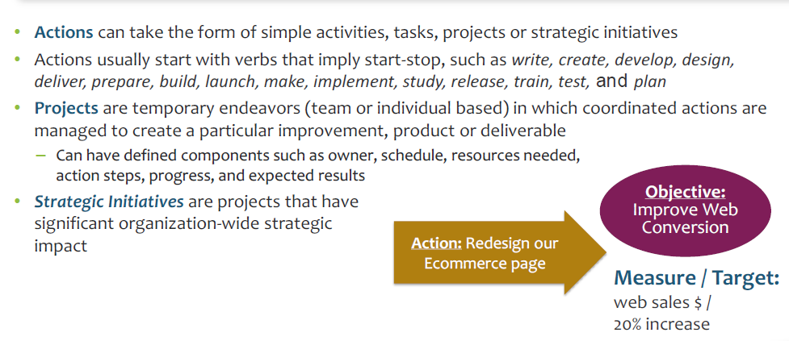
Actions and Projects Are a Means to An End, Not the End Itself

Slide 14
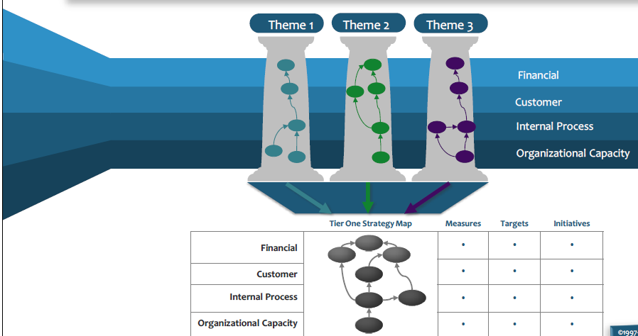
Task 2: Create Enterprise-wide Strategic Objectives from the Theme Objectives

Slide 15
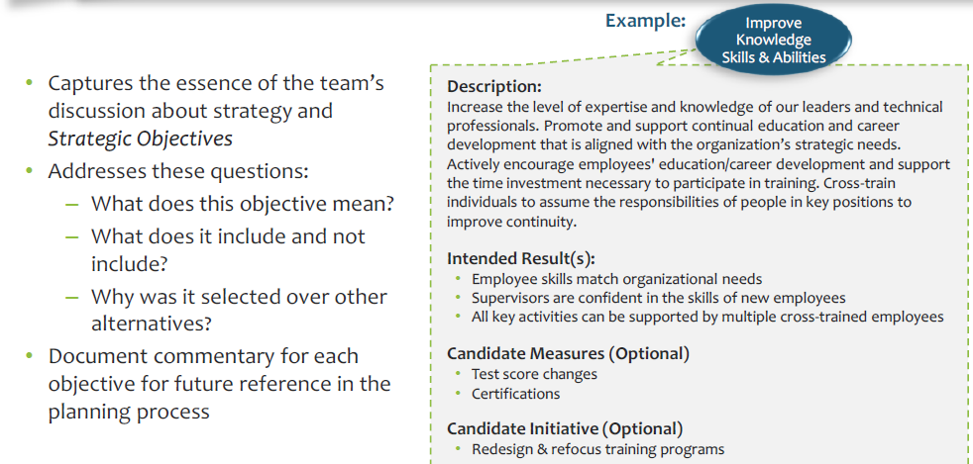
Task 3: Describe and Document Strategic Objectives

Slide 16
Task 4: Identify Objective Owners, Roles, and Responsibilities
Objective Owner Responsibilities:
Builds accountability for results
Proves subject matter expertise
Refines and defines performance measures
Tracks, verifies, and validates performance data
Is aware of initiative affecting objectives
Is aware of what objective(s) are the inputs to this objective and what objective(s) are the outputs from this objective
Reports on objective performance to management and at review meetings
Recommends changes to strategy, measures, and initiatives

Slide 17

Thank You
Questions

